Slide 1
Practical radiological protection culture at school: experience and lessons learned
Jacques LOCHARD
Director of CEPN – France
Vice-chair of ICRP
Technical Meeting on Radiation, Health and Healing
Fukushima Medical University, Japan
9-10 March 2016

Slide 2
What is practical radiological protection culture?
It allows to answer questions about:
where, when and how we are exposed to radiation
when is it worth to protect ourselves
and what we must do to protect us
One possible definition:
The set of knowledge and skills enabling citizens to make choices and behave wisely in daily situations involving ionizing radiation
Notes:
09/03/16
1

Slide 3
About practical radiological protection culture
This notion emerged in the context of the ETHOS project and the CORE program in Belarus (1996-2008)
Closely linked to the co-expertise process implemented with the small groups of villagers engaged in improving their living conditions
Development of practical radiological protection culture implies:
To give access to individuals to measurements in order to characterize the exposure situation they are confronted with
To set up forum to allow individuals to express their concerns and expectations, share information, validate measurements and diffuse experience
Notes:
09/03/16
2

Slide 4
Practical radiological protection culture at school
In the course of the ETHOS project and the CORE programme teachers progressively realized that the approach adopted for the education of children at school on radiation issues was inadequate because based on:
a theoretical learning that was not meaningful for the students in their daily life in the village
a list of prohibitions and requirements that were not adapted to living conditions and lifestyles of children specific to each village
This observation led the teachers involved to mobilize themselves to transmit the practical radiological protection culture to their students.
Notes:
09/03/16
3

Slide 5
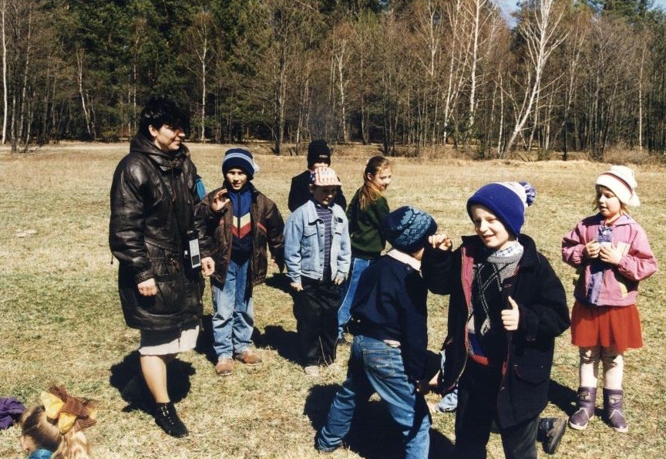
Discovering the radiological situation (1)

Slide 6
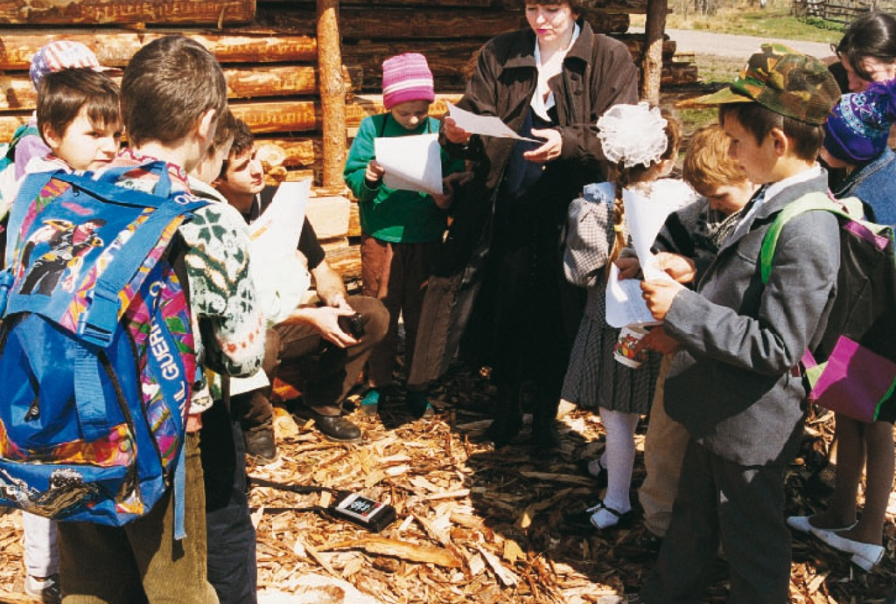
Discovering the radiological situation (2)

Slide 7
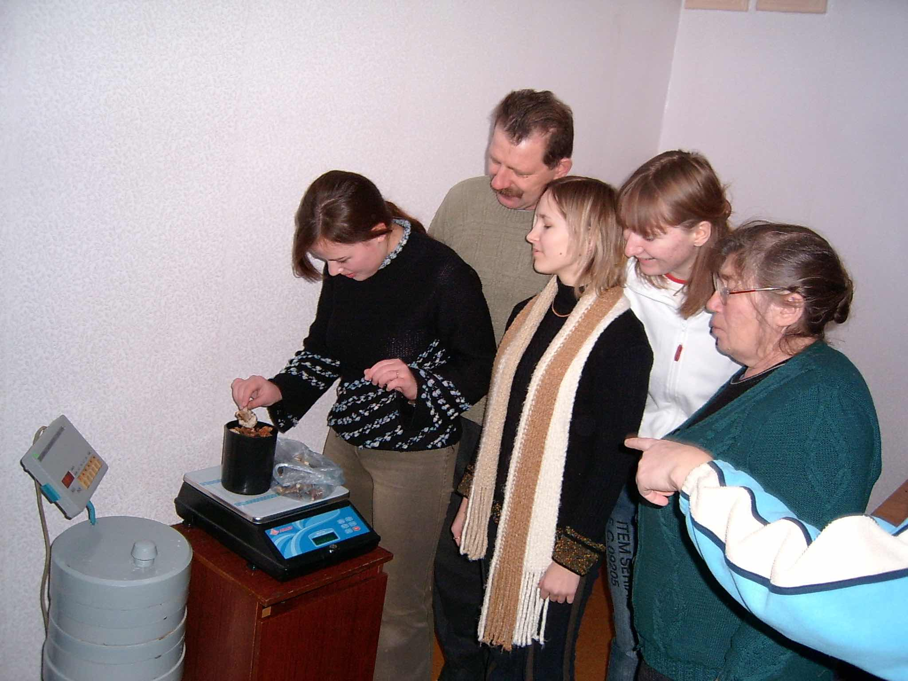
The measurements of foodstuffs (1)

Slide 8
The measurement of foodstuffs (2)

Slide 9
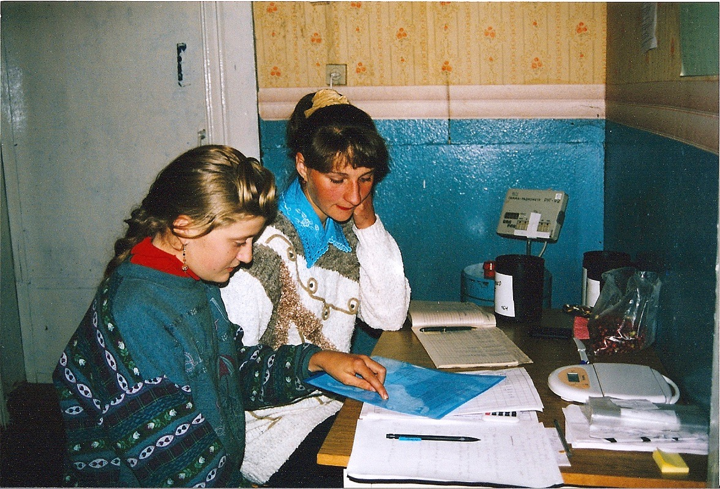
Analysing results of measurements

Slide 10
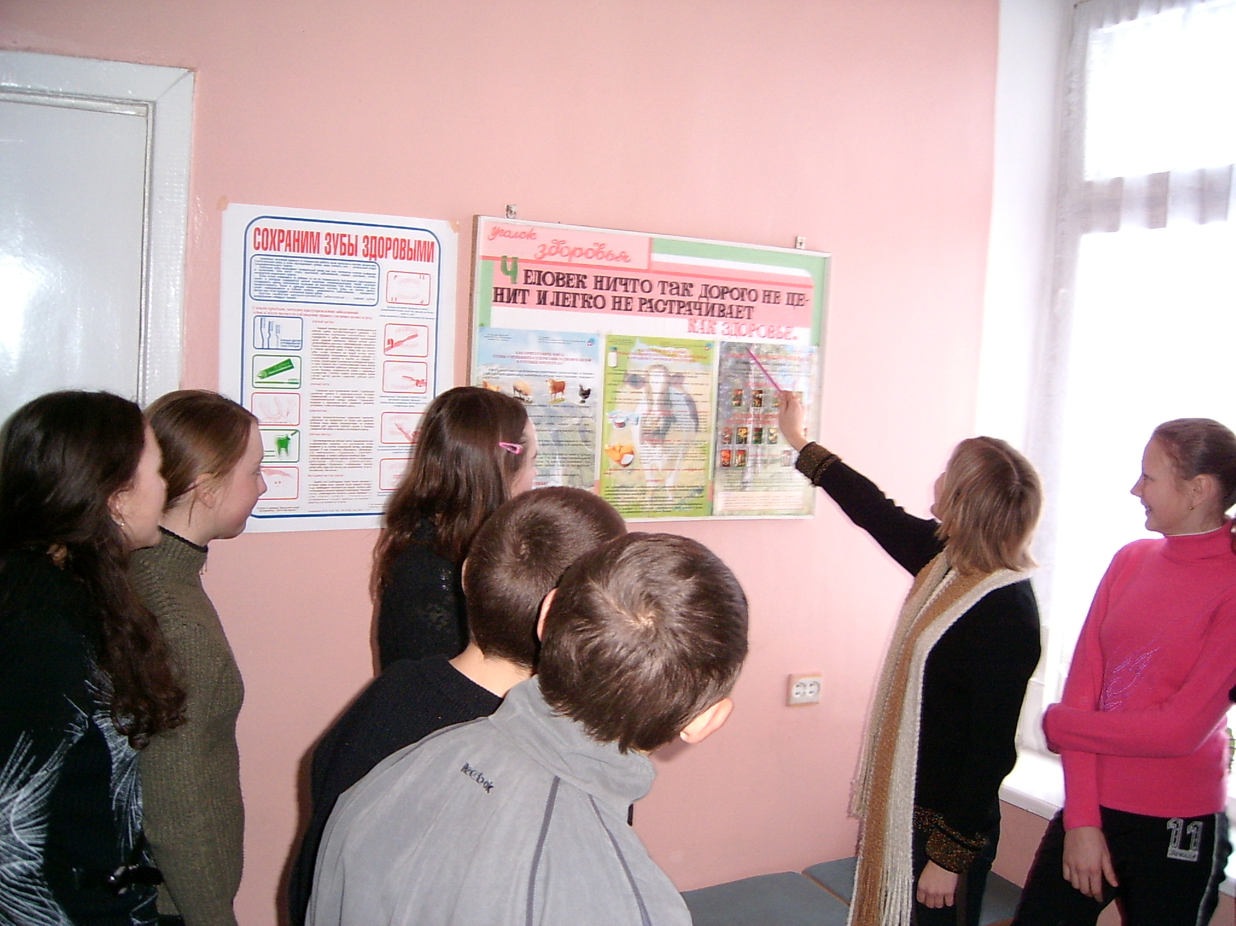
Sharing results

Slide 11
Discovery of Chernobyl in kindergarten
10

Slide 12
Lessons learned in Belarus
Experience showed that it is possible to develop practical radiological protection culture among primary and high school students but also to talk with small children in kindergartens
The approach implies cooperation of teachers with radiation protection experts, but also experts from health, agriculture, ...
The knowledge on radiation only make sense if students can connect it with the problems of the communities in which they live and also with stakeholders involved in rehabilitation
Experience has also shown the importance of sharing experience between pupils and students from different communities in order to put the respective situations into perspective
It also highlighted the vital role of working on memory for a generation that has not experienced the accident in order to engage in dialogue with parents and the family
Notes:
09/03/16
11

Slide 13
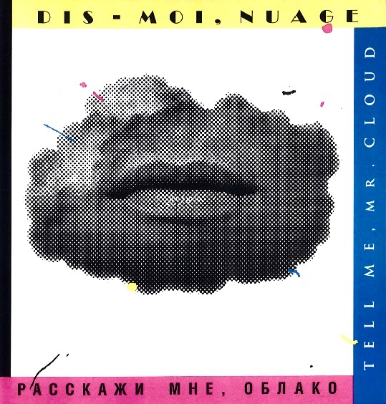
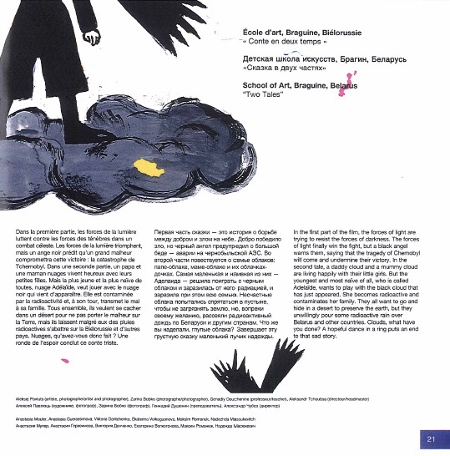
The ‘Tell me Mr Cloud’ project within the CORE program

Slide 14
The ‘High school radiological protection workshops”
Initiated in 2008 by CEPN in cooperation with the French Institute for Radiological Protection and Nuclear Safety (IRSN), the Bois d’Amour high school in Poitiers, and the Scientific, technical and industrial culture centre of Franche-Comté in Montbéliard in France on the basis of:
the Belarus experience, in particular the Belarus and French exchange of high school students in spring 2005
the « Did you say radiation protection? » exhibition inaugurated in October 2007
Since their creation, the workshops have involved more than 1,000 students and teachers from 30 different schools, respectively 17 French and 13 foreign schools: Belarus, Belgium Germany, Italy, Japan, Moldova, Morocco, Romania, Ukraine
Notes:
09/03/16
13

Slide 15
The French and Belarus exchange between high schools
17 Belarus students with 4 teachers spent a week in Poitiers, France in March 2005
They presented the situation in the contaminated areas they were living in to the French students and teachers as well as the students’ families
17 French students with 4 teachers spent a week in the Stolyn district, Belarus in April 2005
Preparatory works of students and meeting to inform families before leaving France
First visit of foreign high school students in the contaminated areas of Belarus 19 years after the Chernobyl accident
Notes:
09/03/16
14

Slide 16
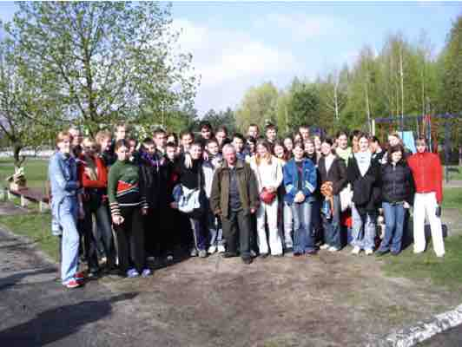
The Belarus and French high school students

Slide 17
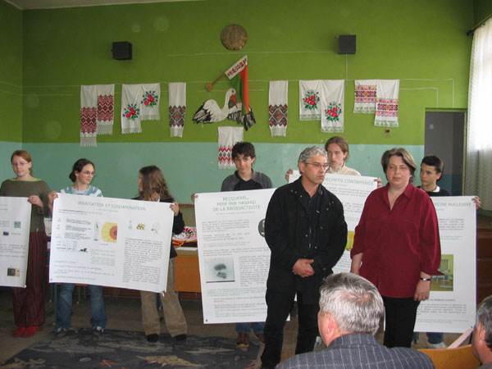
Presentation of the works of students

Slide 18
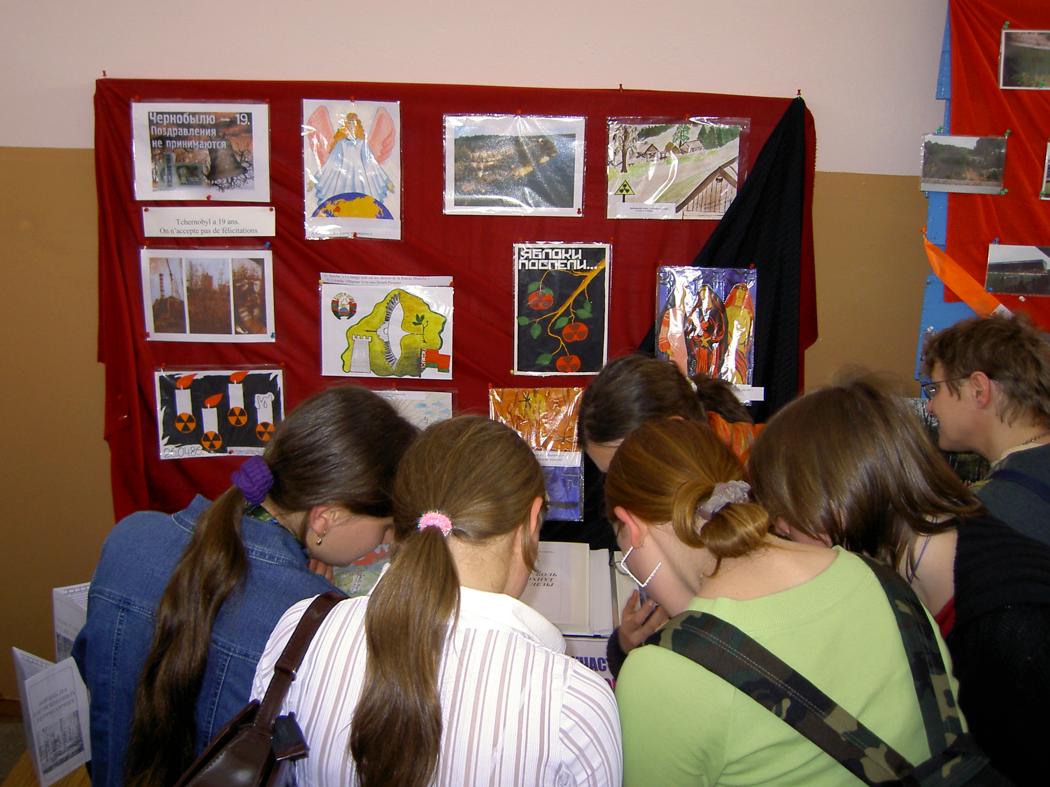
Sharing information between students

Slide 19
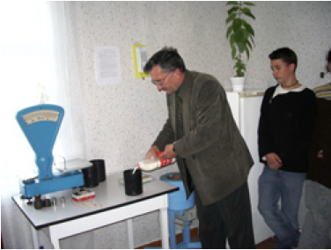
Measurement of a milk sample

Slide 20
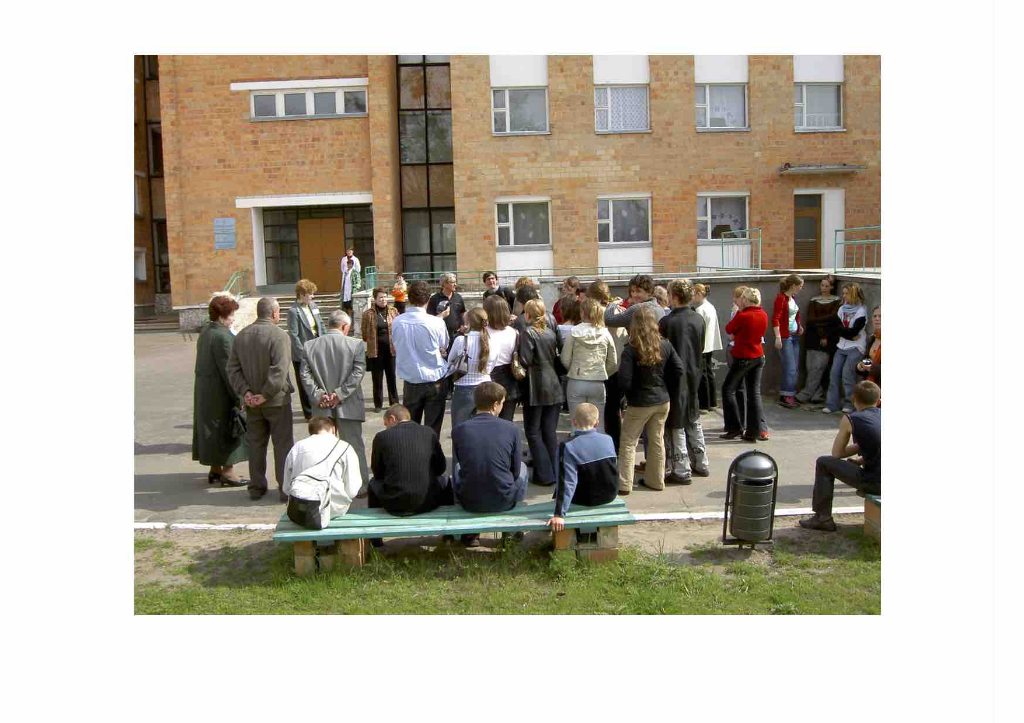
Visit of the Stolyn hospital

Slide 21
The « Did you say Radiation Protection? » exhibition in November 2007
Produced by the Scientific, technical and industrial culture centre of Franche-Comté with the support of IRSN, France
Targeting particularly primary and high school students
With the cooperation of the Curie Museum – Paris and the Röntgen Museum, Remscheid, Germany
Ten works of art and ten video films
A catalogue on the history of X-ray, radioactivity and radiological protection
Presented in France, Argentina, Switzerland, Finland
Notes:
09/03/16
20

Slide 22
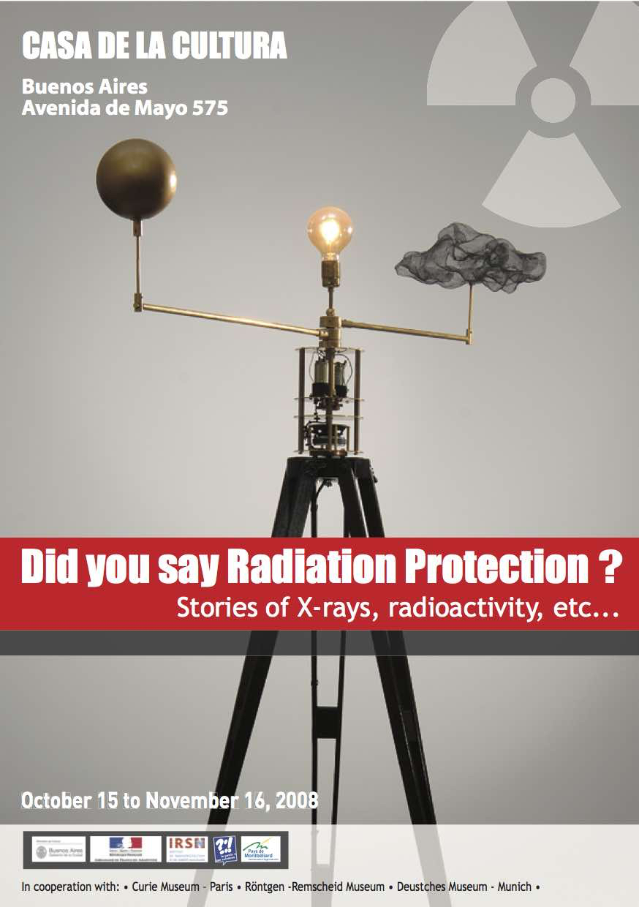
Posters of the « Did you say Radiation Protection? » exhibition
Notes:
09/03/16
21

Slide 23
Objectives and organisation of the workshops
To contribute to promoting scientific and technical culture in high schools
To initiate a civic approach as part of an appropriation of scientific, ethical and societal dimensions related to ionizing radiation
Based on the voluntary commitment of teachers and students with the support of high school administrations and organizations involved in radiological protection
Three aspects:
A preparation time: practical works and experts lectures at schools from September to February
A time of sharing between students and teachers in March
An international dimension
Notes:
09/03/16
22

Slide 24
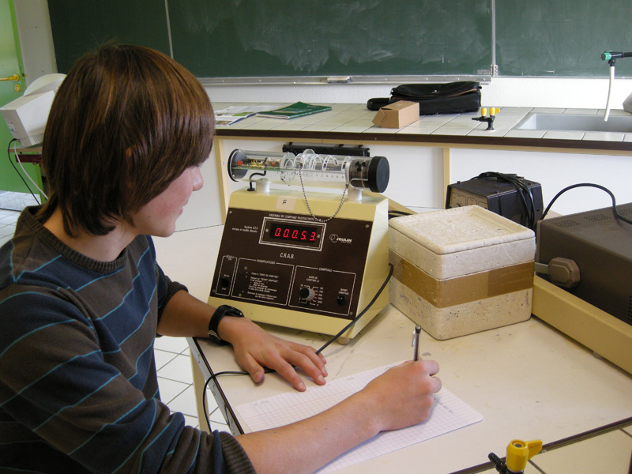
Practical exercices (1)

Slide 25
Practical exercices (2)

Slide 26
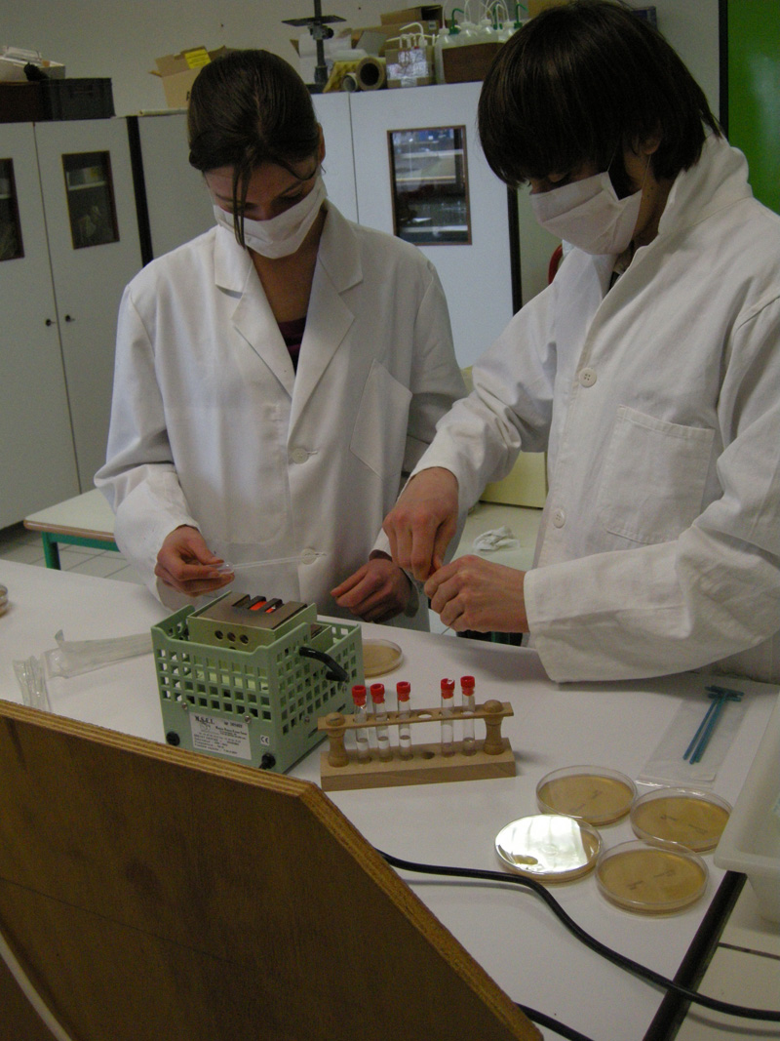
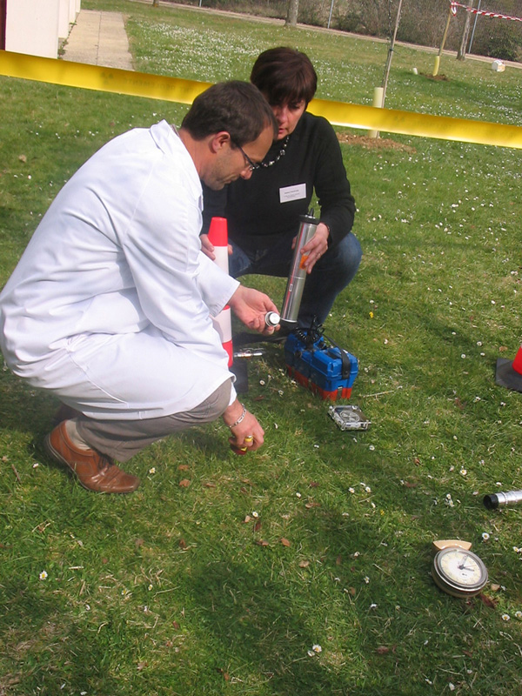
Practical exercices (3)

Slide 27
Lecture at high school by professionals

Slide 28
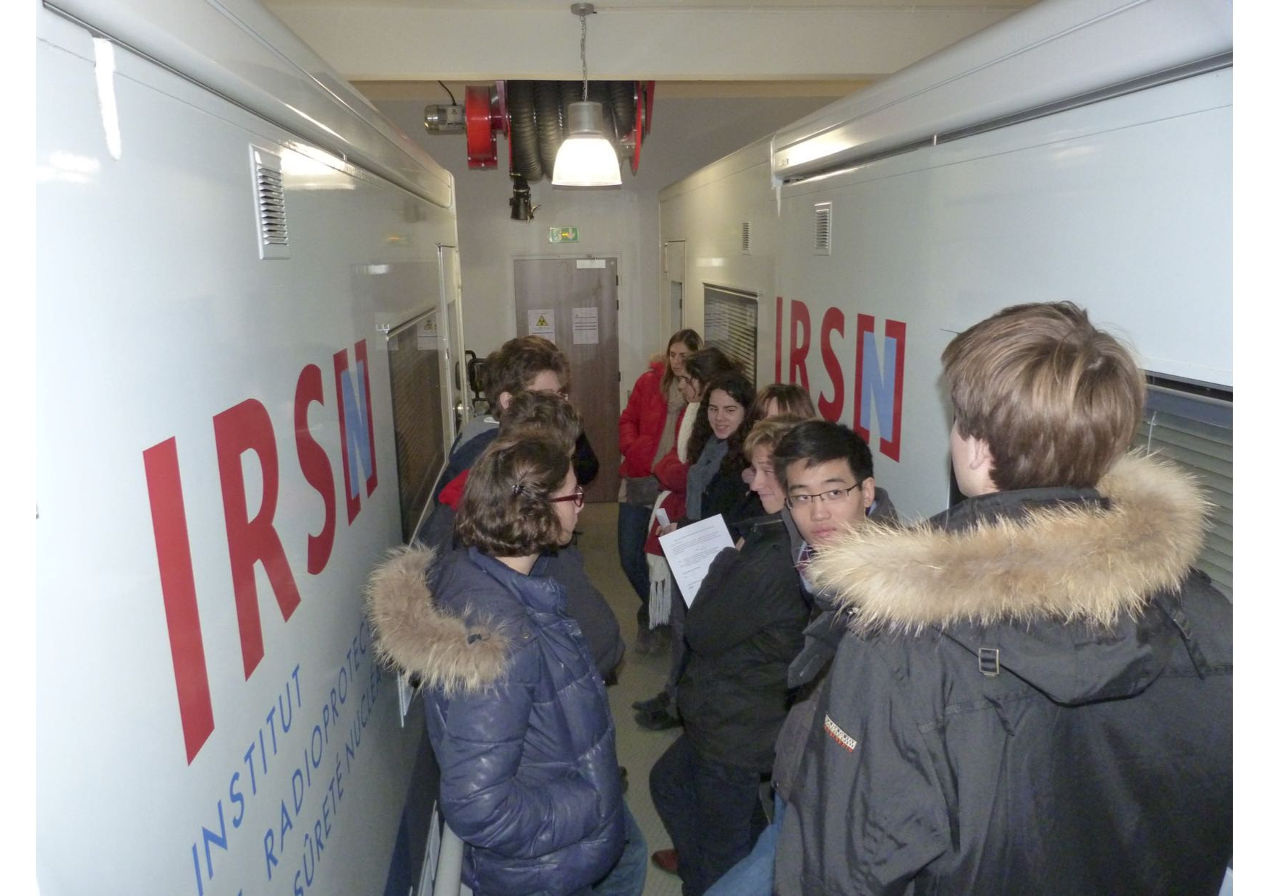
Visit of a laboratory

Slide 29
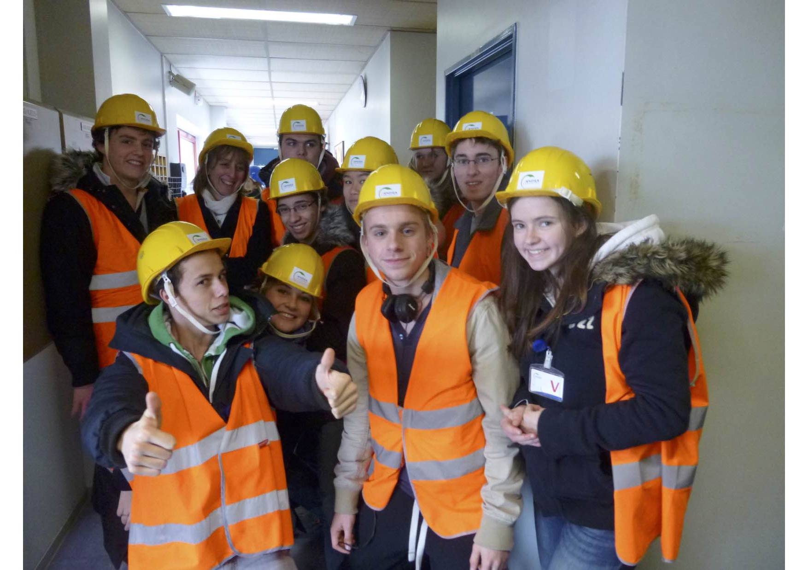
Visit of an installation

Slide 30
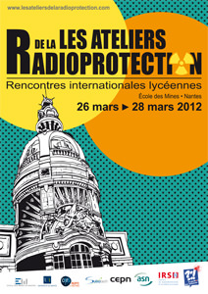
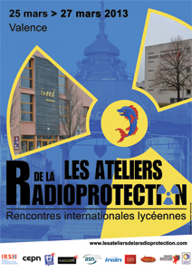
The posters of the 2012 and 2013 workshops

Slide 31
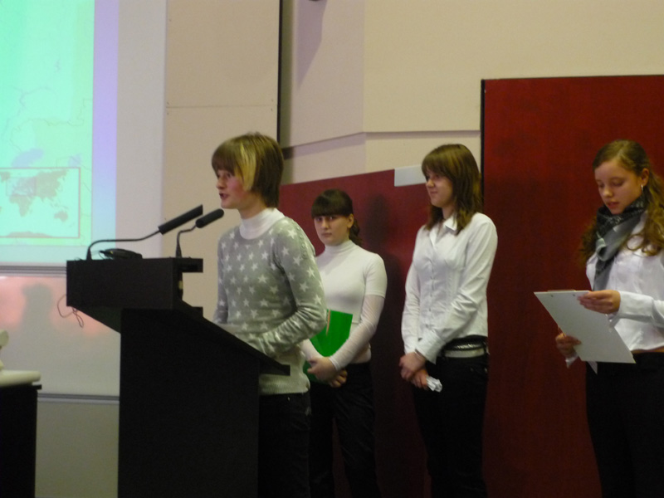
Oral presentation at a workshop (1)

Slide 32
Oral presentation at a workshop (2)

Slide 33
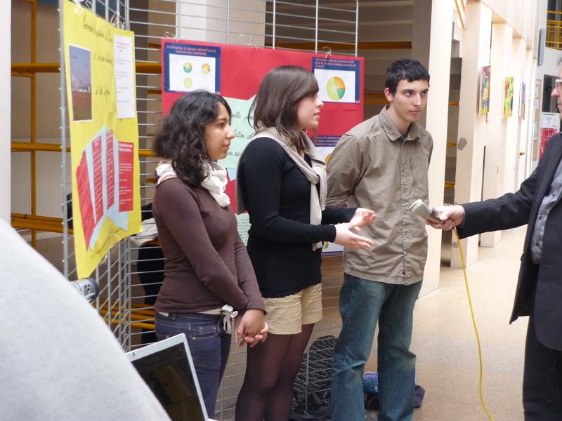
Poster presentation at a workshop (1)

Slide 34
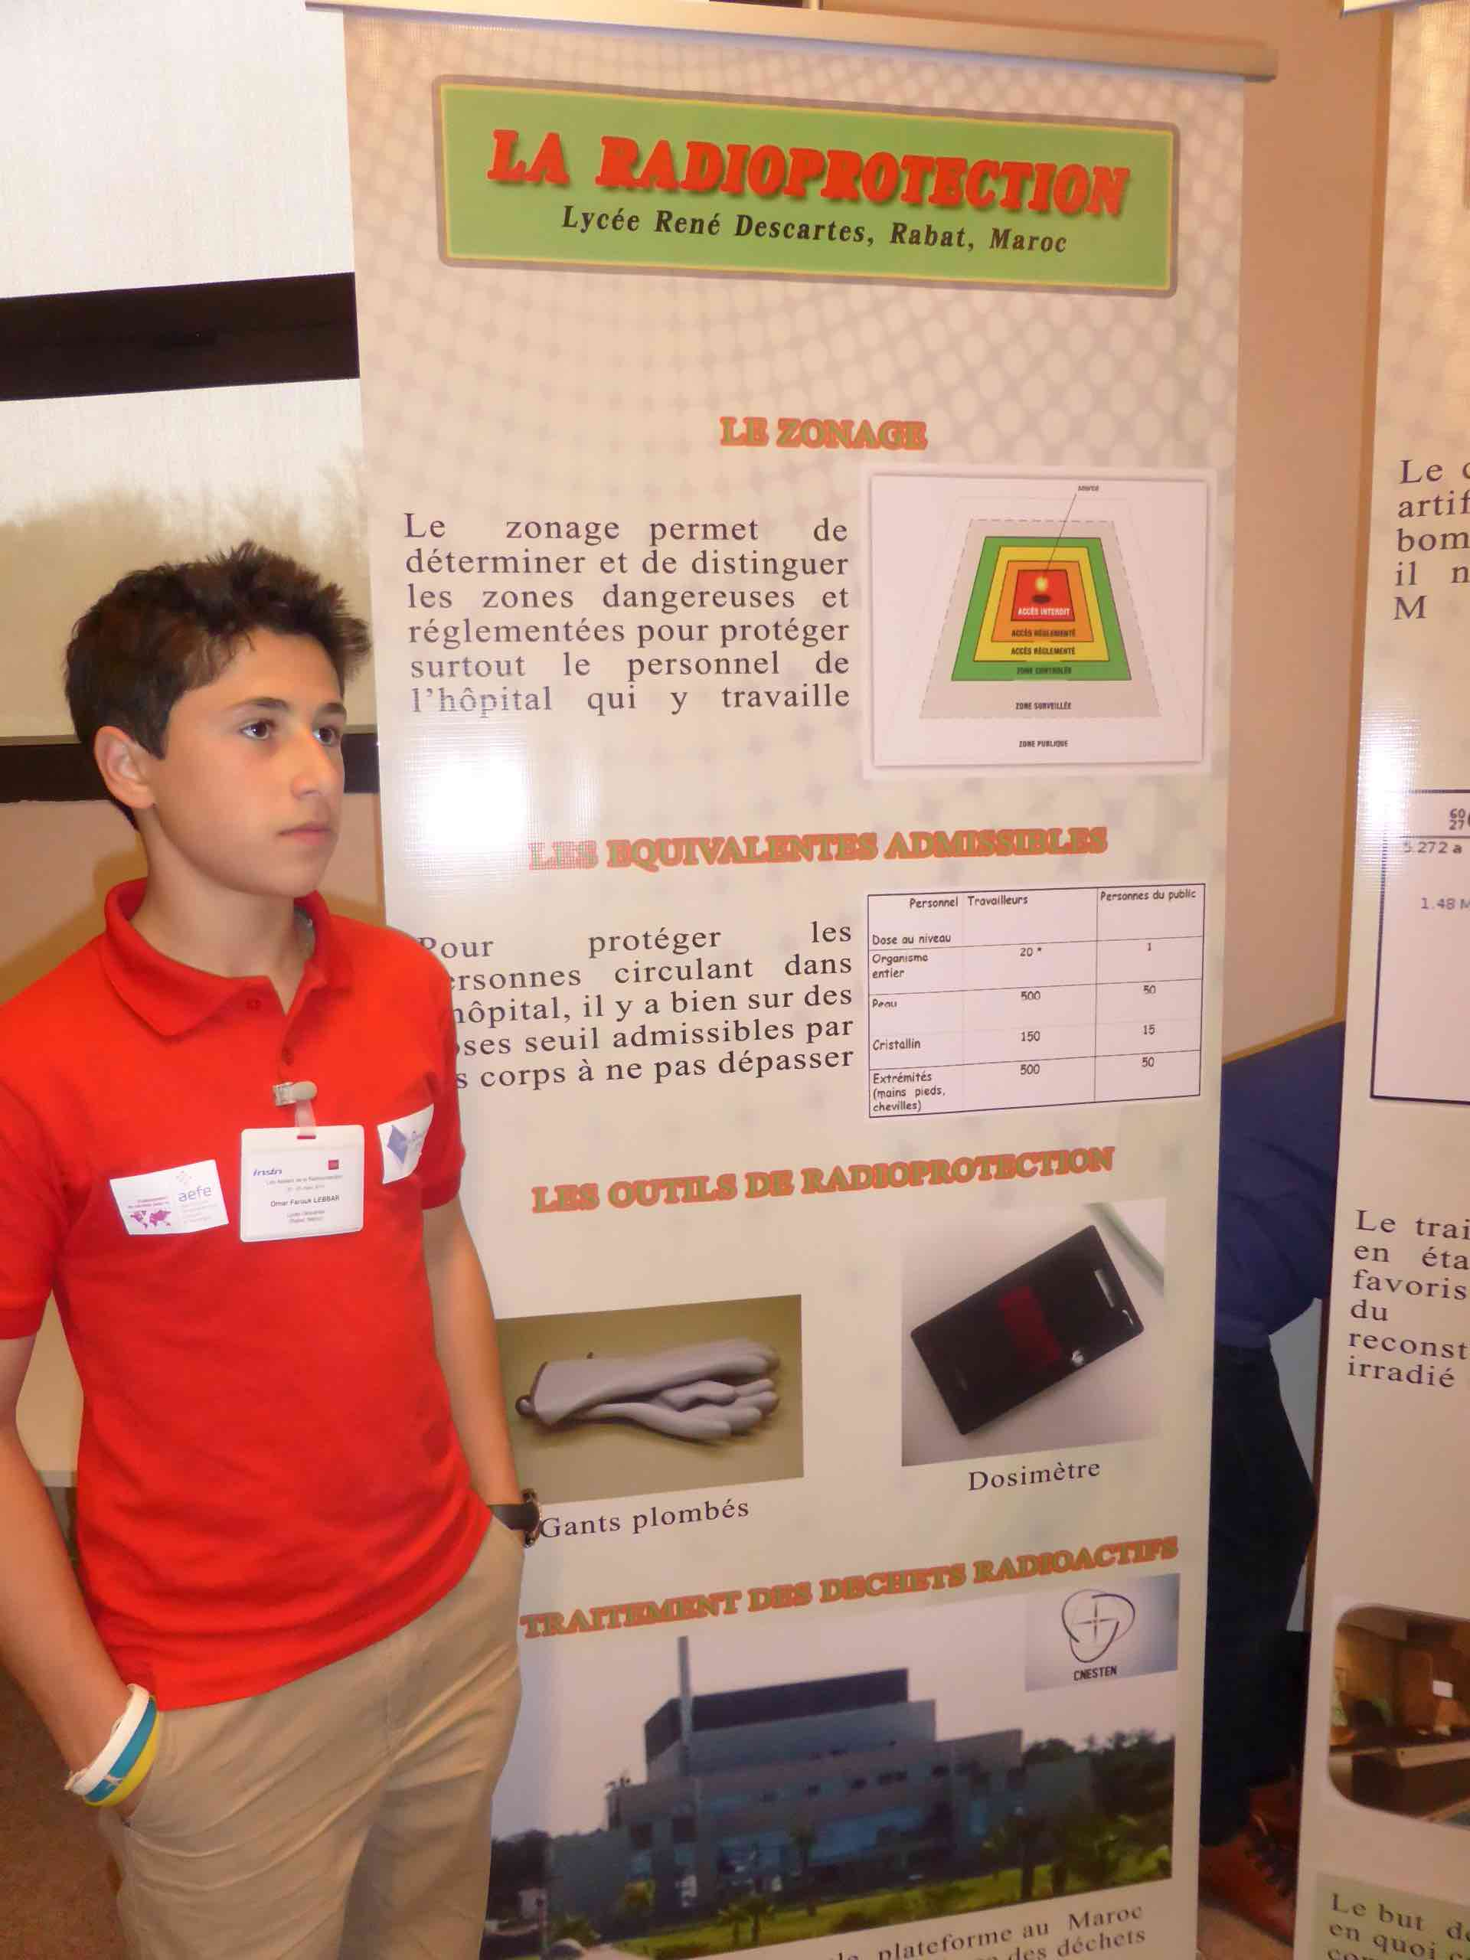
Poster presentation at a worshop (2)

Slide 35
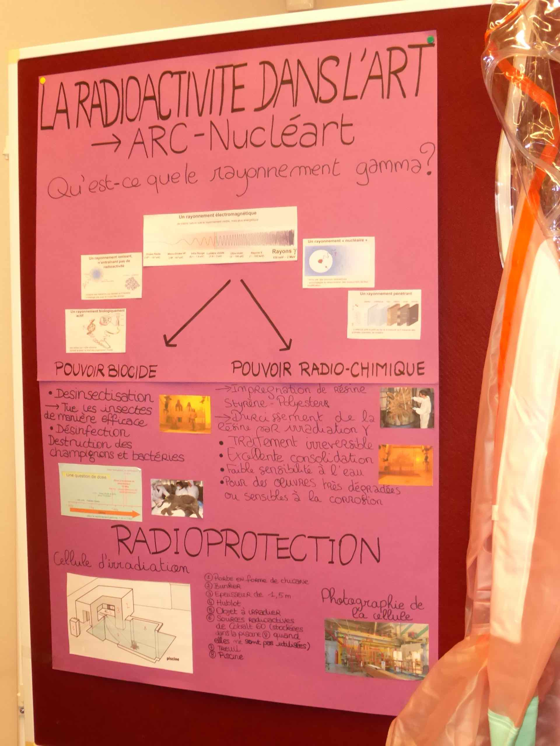
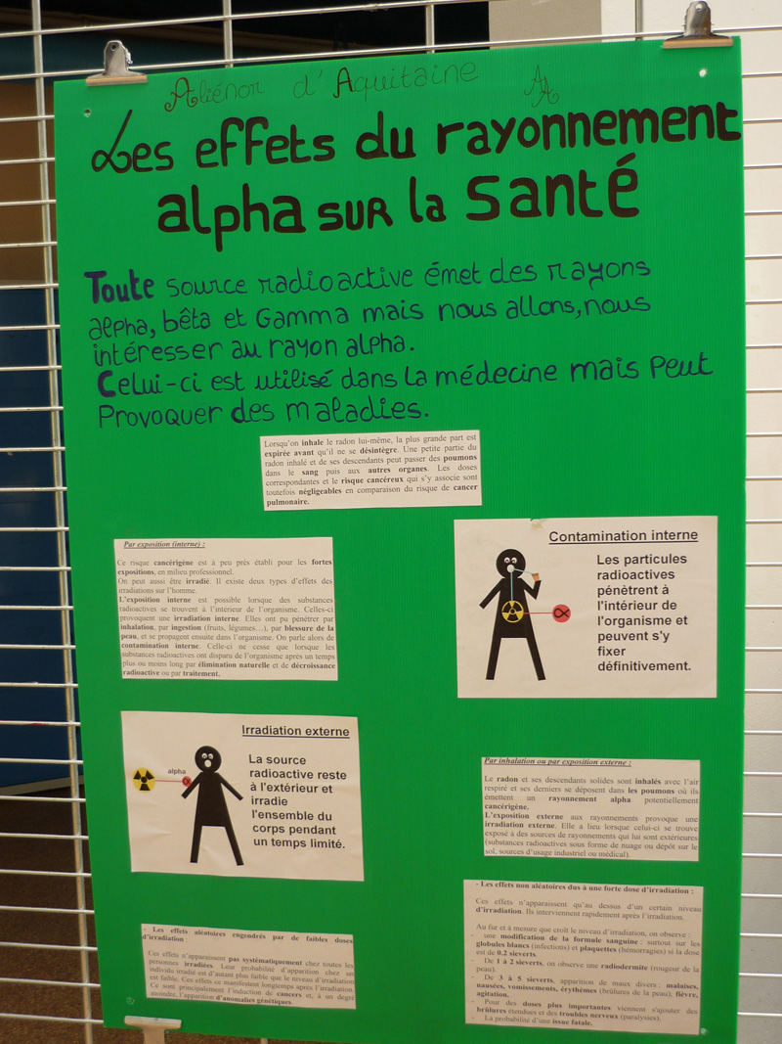
Posters presented in workshops

Slide 36
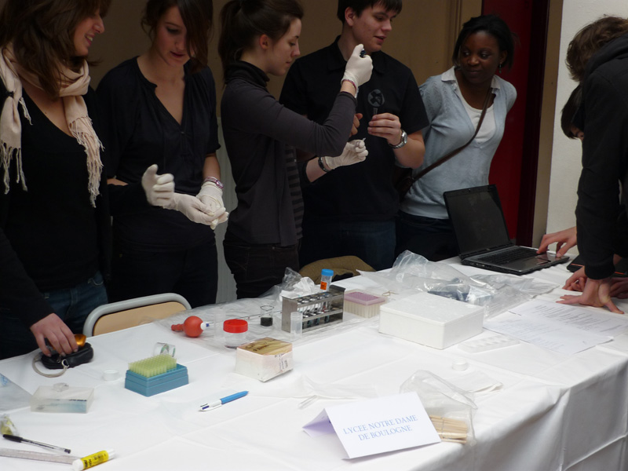
Presentation of a manip at a workshop

Slide 37
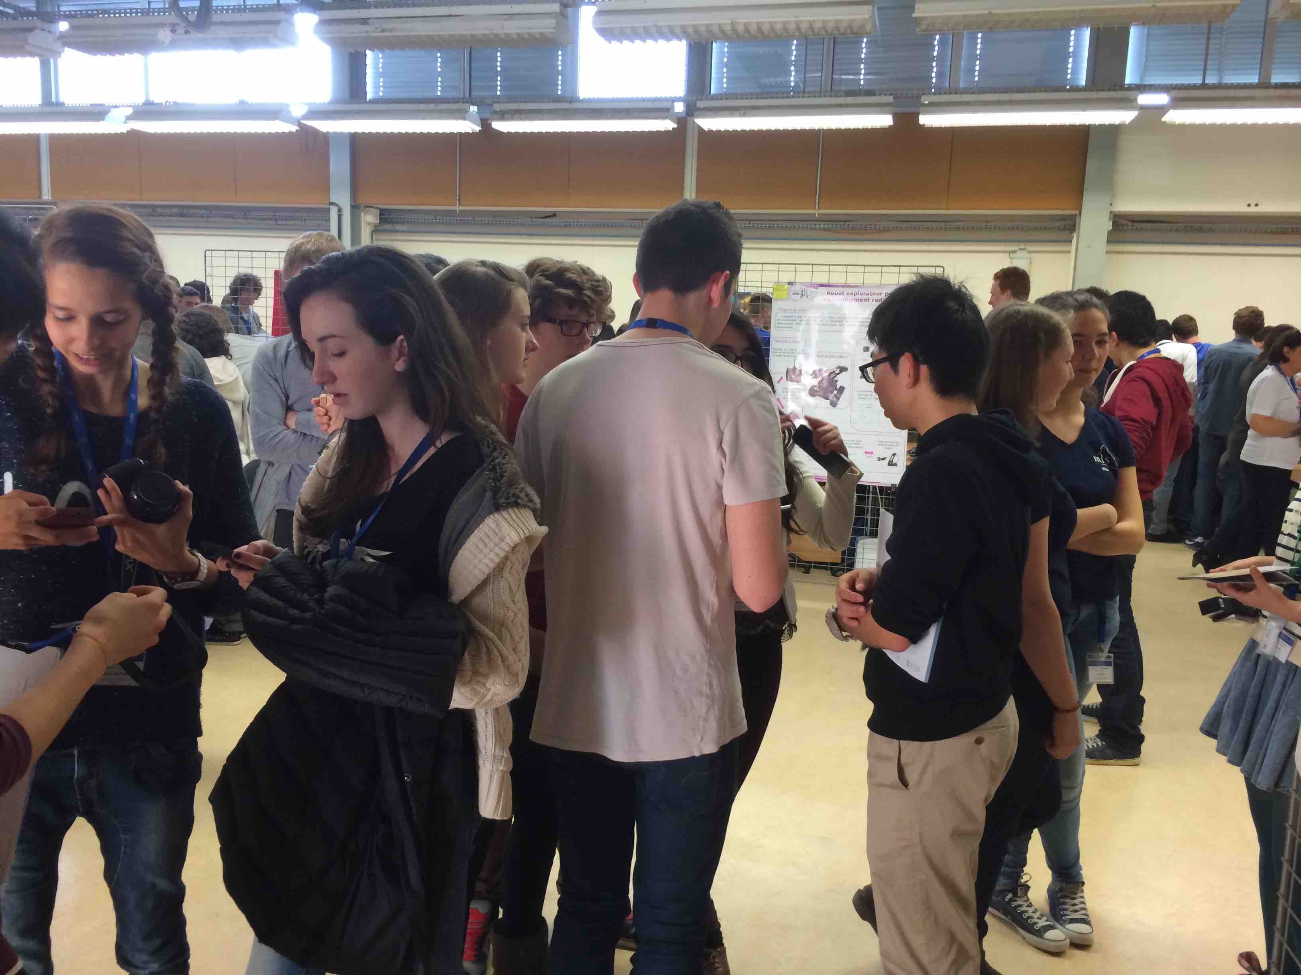
Sharing experience

Slide 38
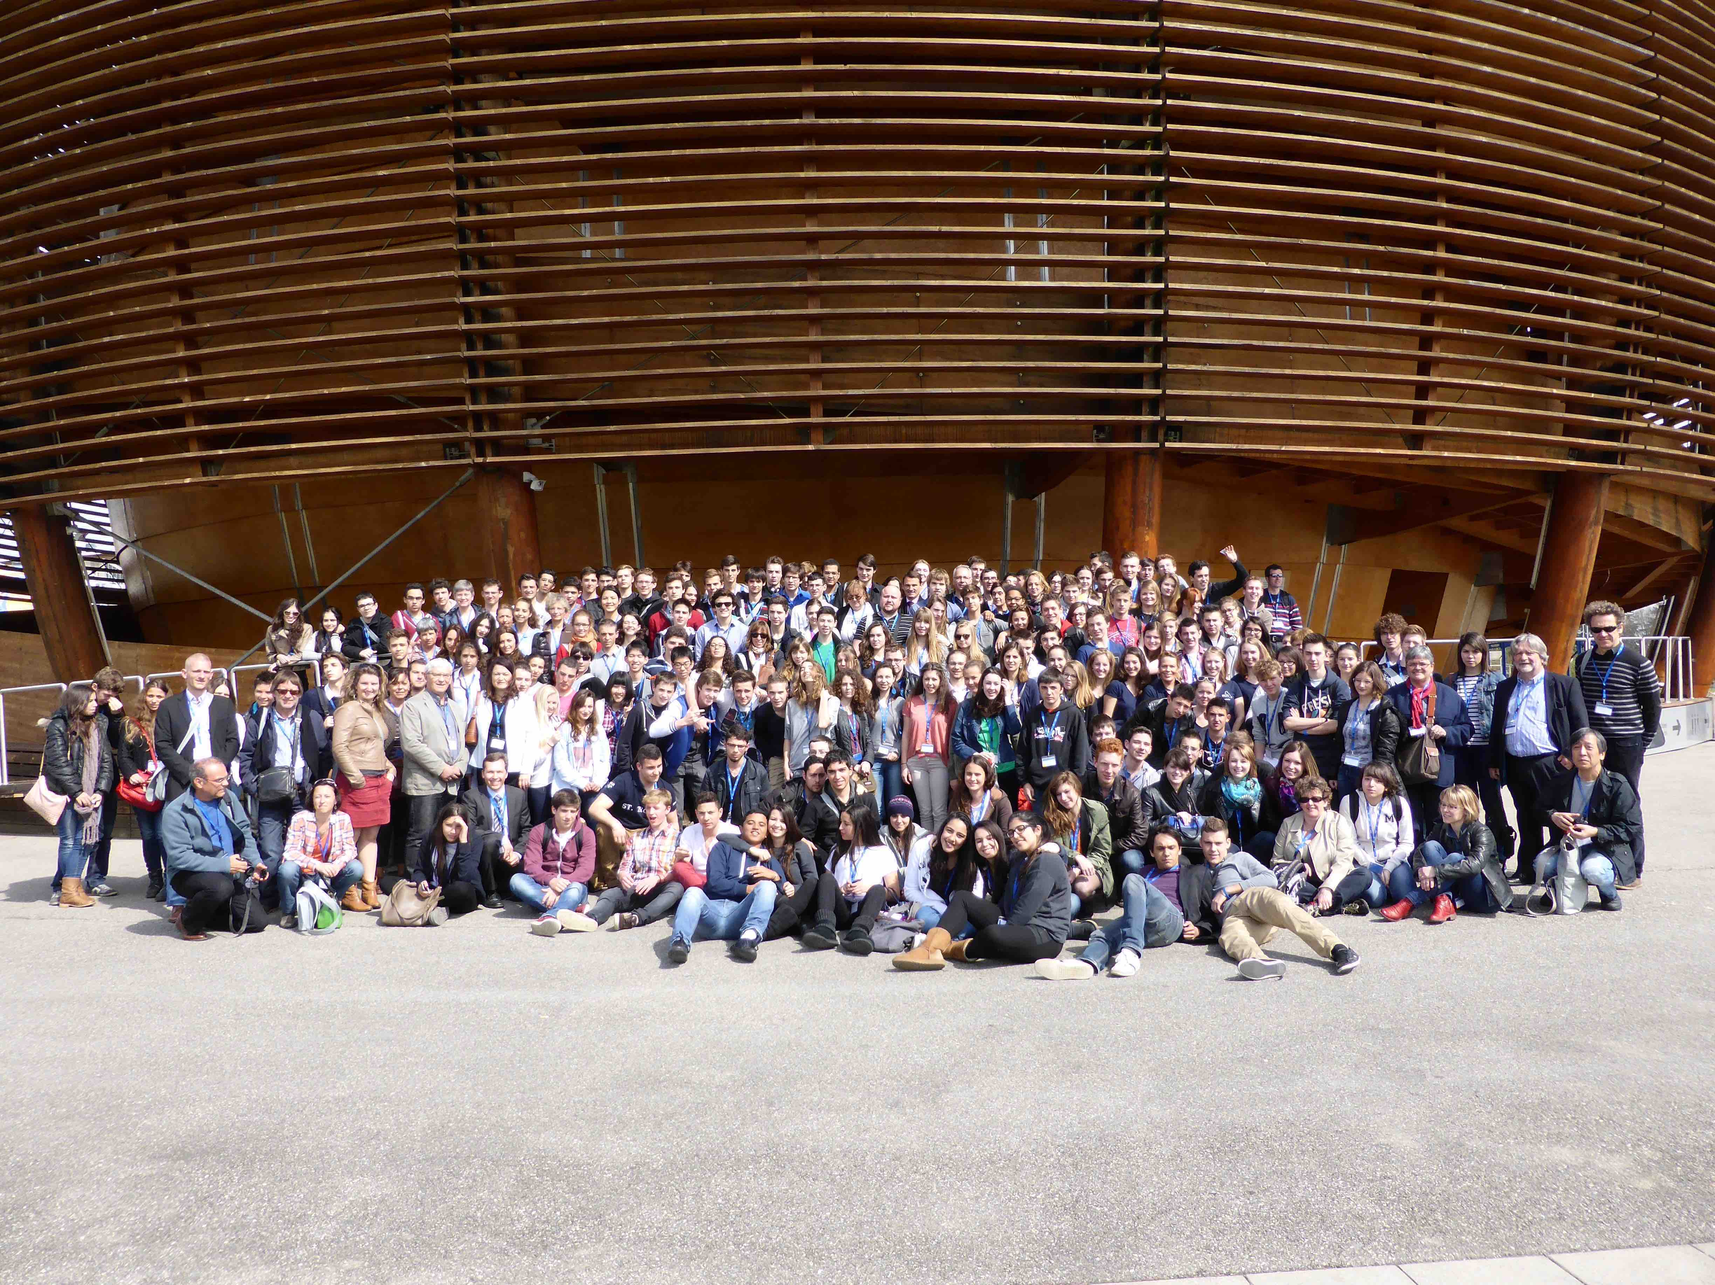
The CERN Workshop, Switzerland – March 2014

Slide 39
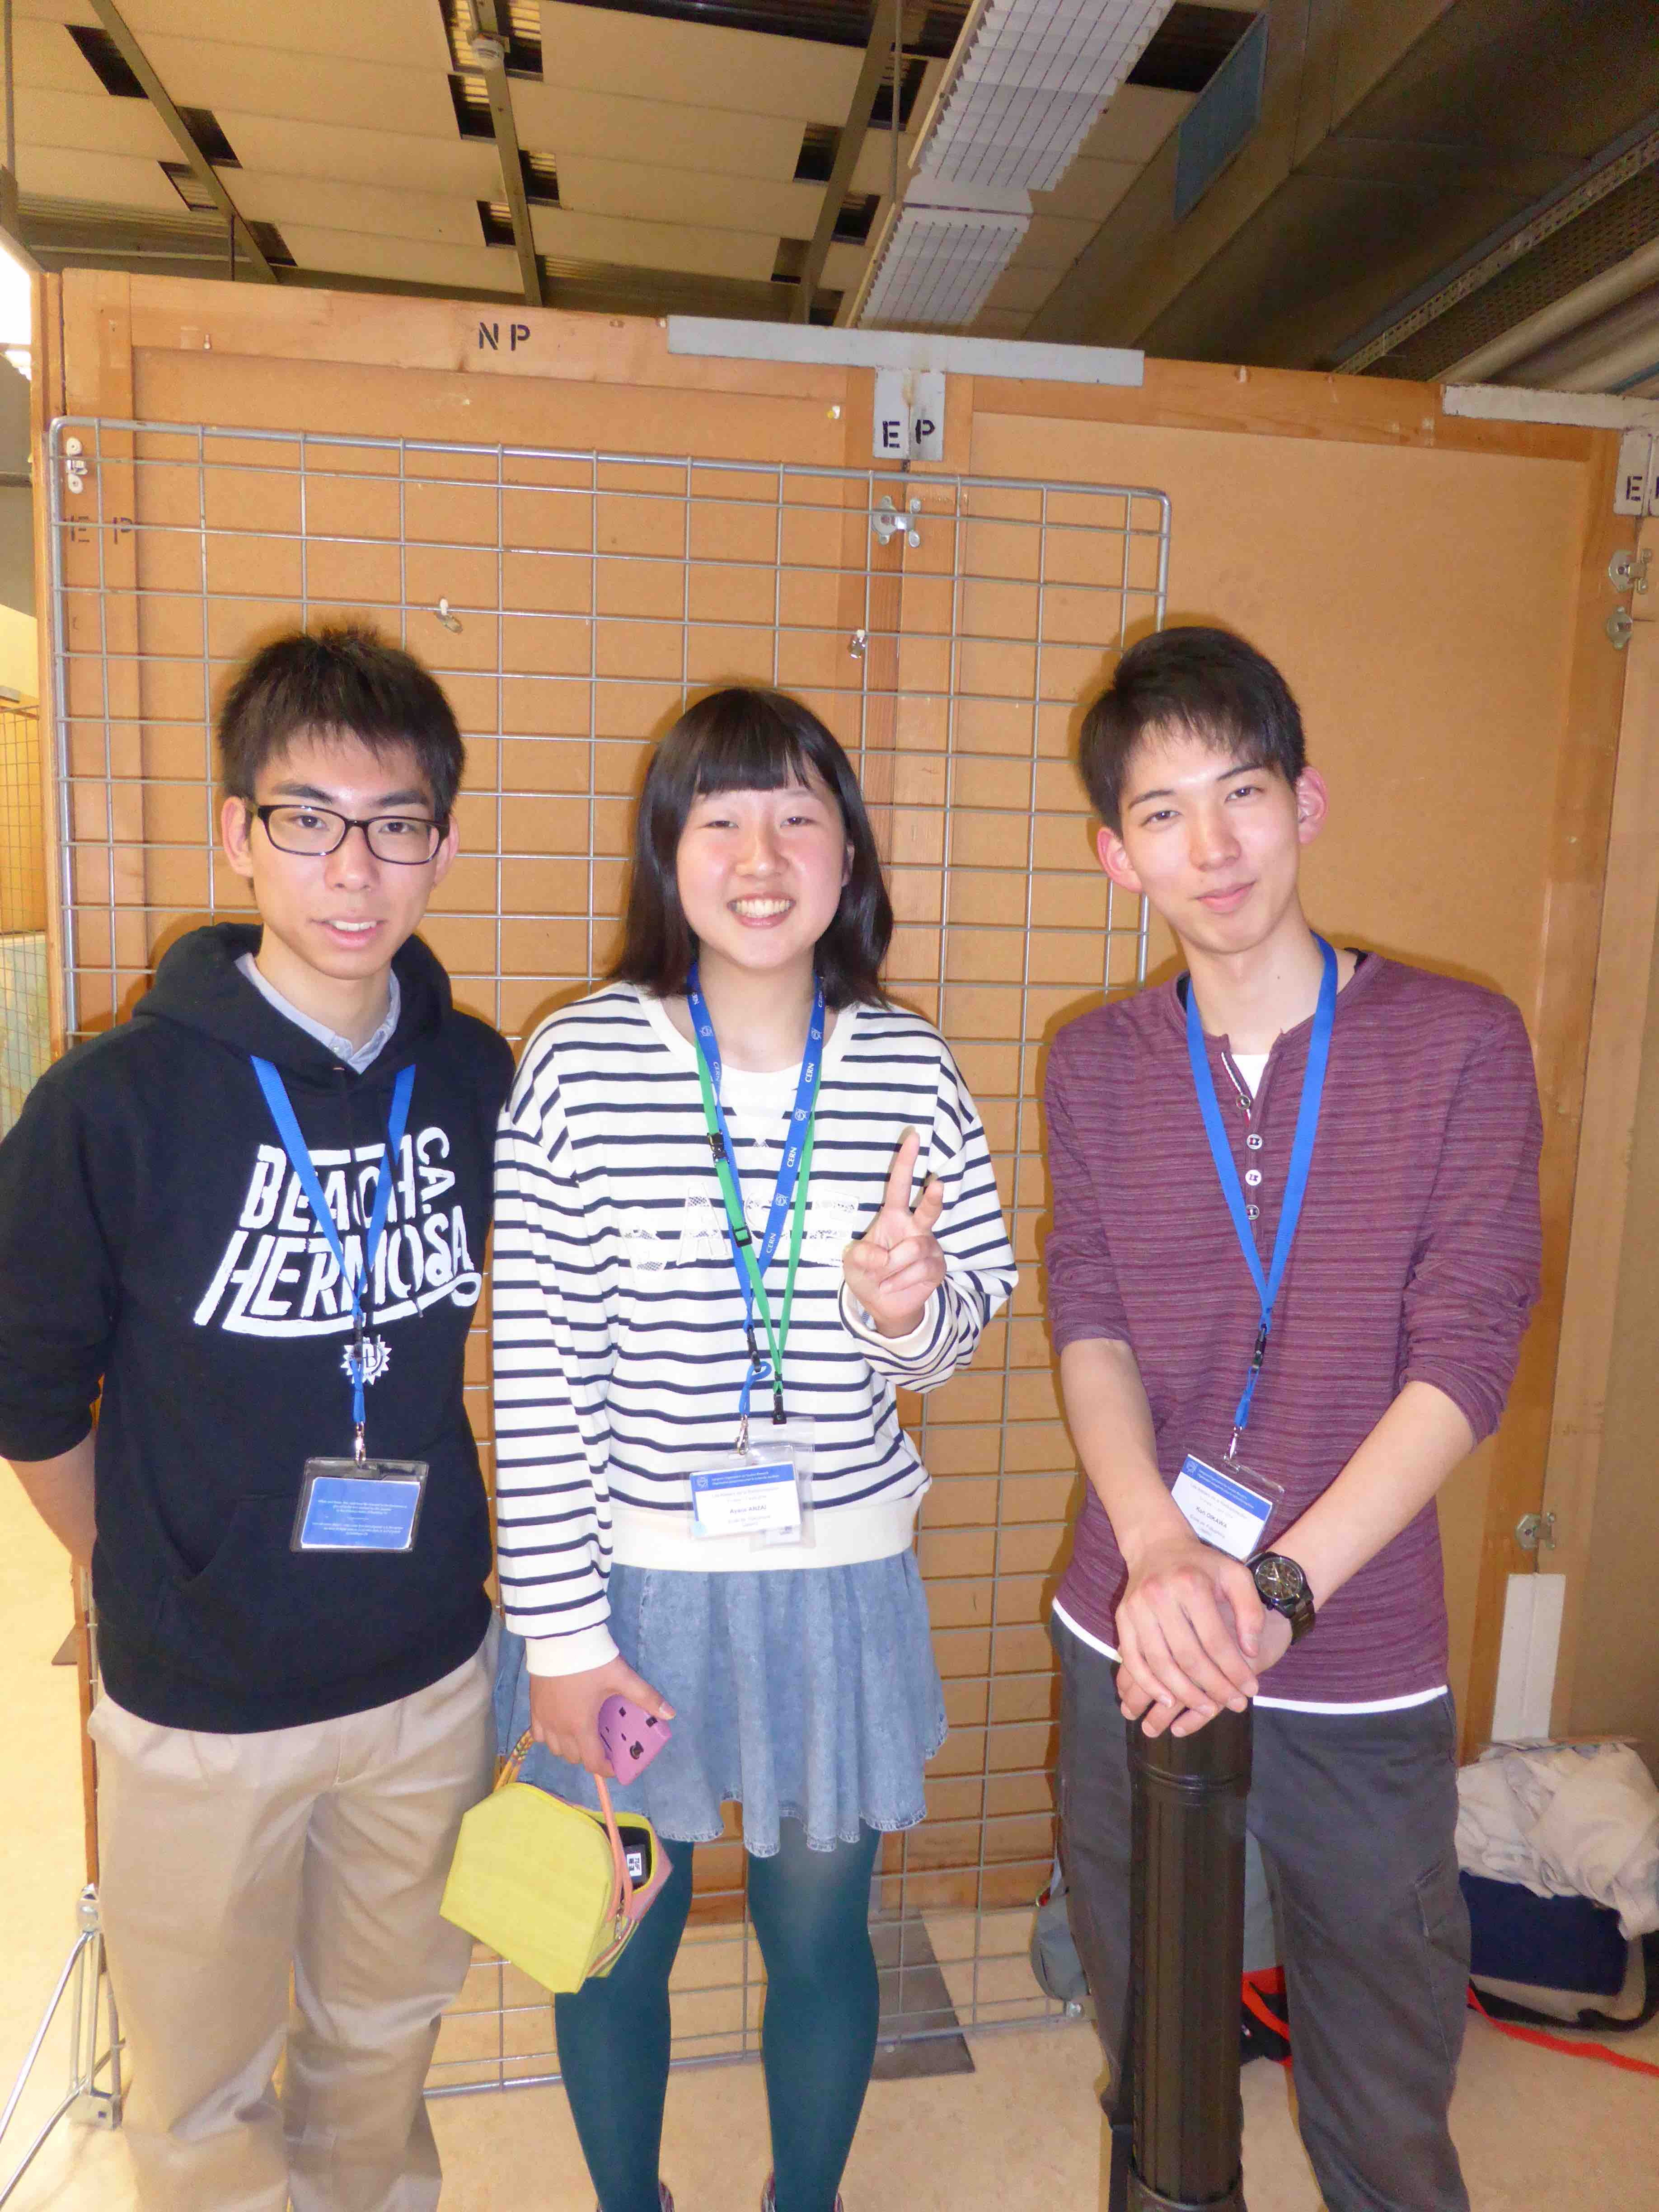
The Japanese students at the CERN workshop

Slide 40
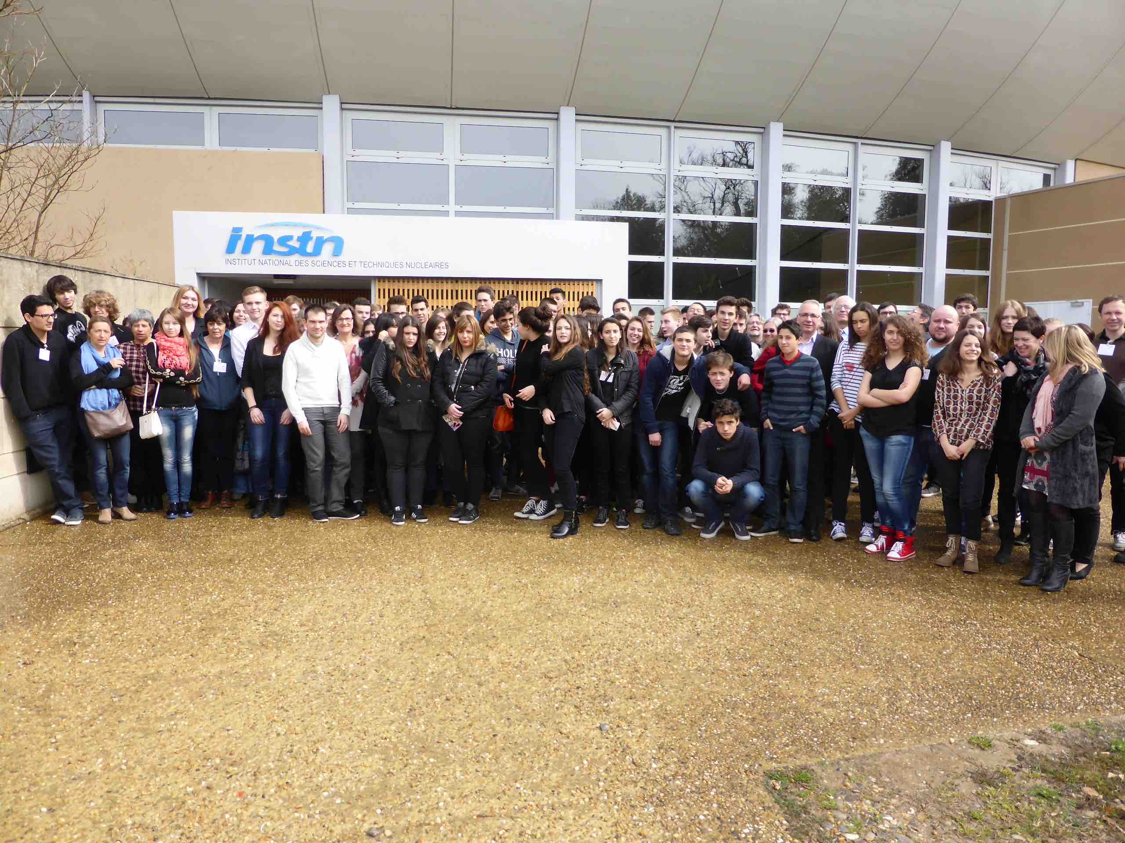
The Cadarache Workshop – March 2015

Slide 41
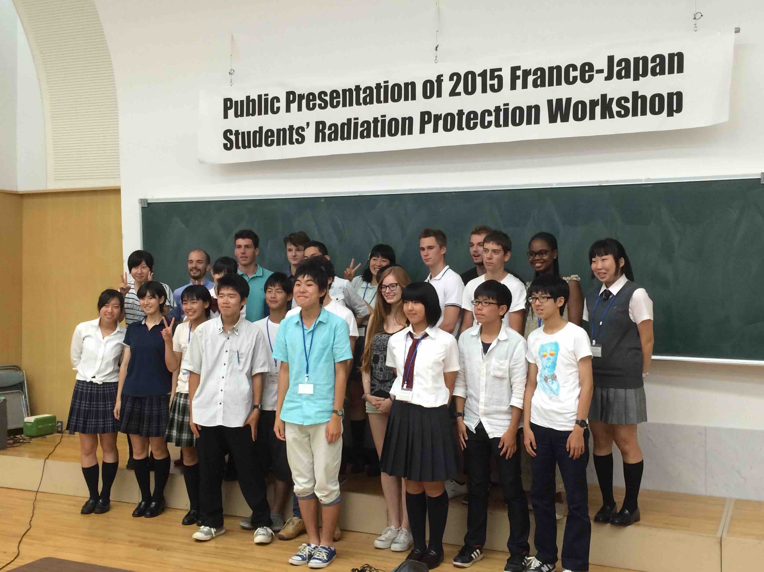
The French-Japan Students’ radiation protection workshop – Fukushima, 3-8 august 2015

Slide 42
Participants and programme of the workshop
8 students an 2 teachers from 2 high schools from France
13 students and 2 teachers from Fukushima high school
2 French and 3 Japanese experts
Reception at the French Embassy
Seminar at the Tokyo university
Field visits and practical exercices
Seminar at the Fukushima high school

Slide 43
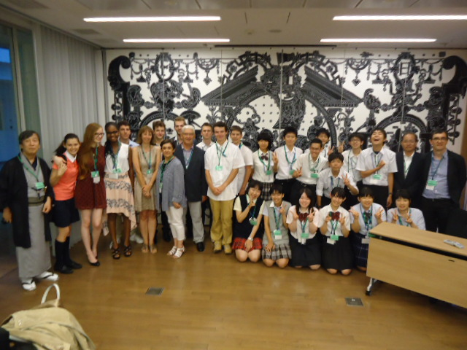
Reception at the French Embassy

Slide 44
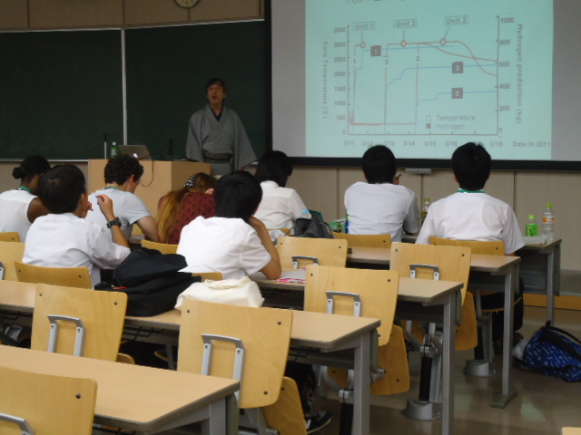
Lecture at the University of Tokyo
→

Slide 45
Visit of Iwaki – Tomioka – Miyakoji – Iwaki - Fukushima
→

Slide 46
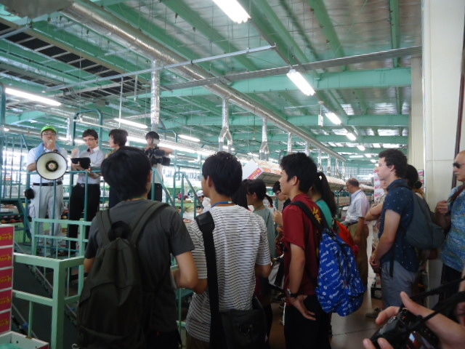
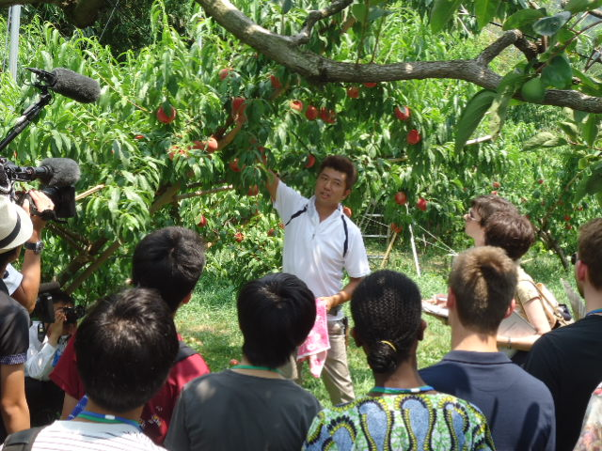
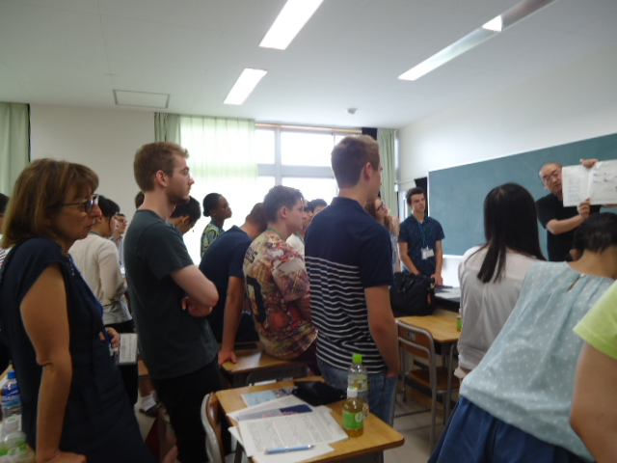
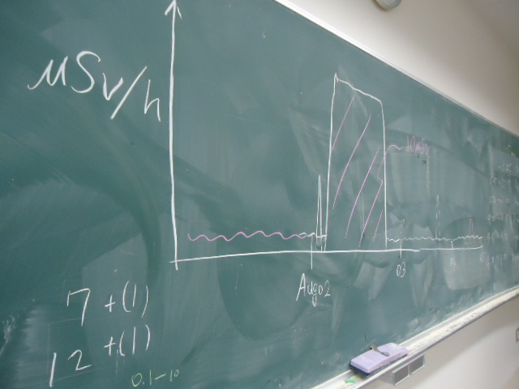
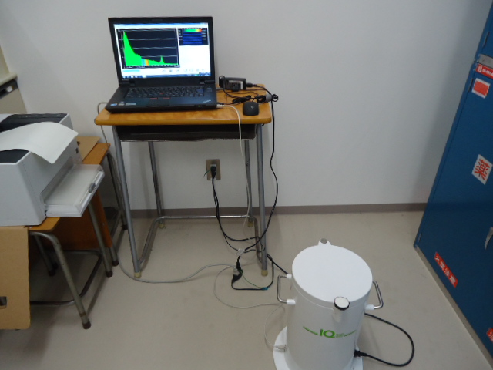
Visit of Kunimi – Thyroid Lecture – Experiments
→

Slide 47
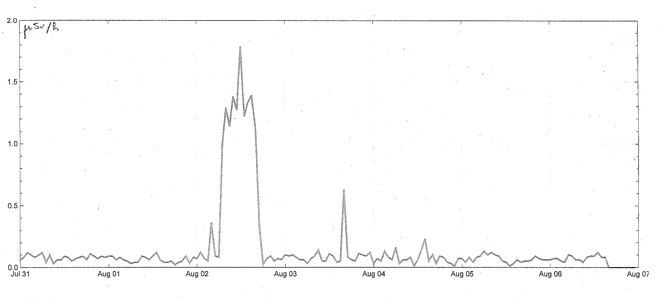
A D-shuttle ‘profile’ of a French student

Slide 48
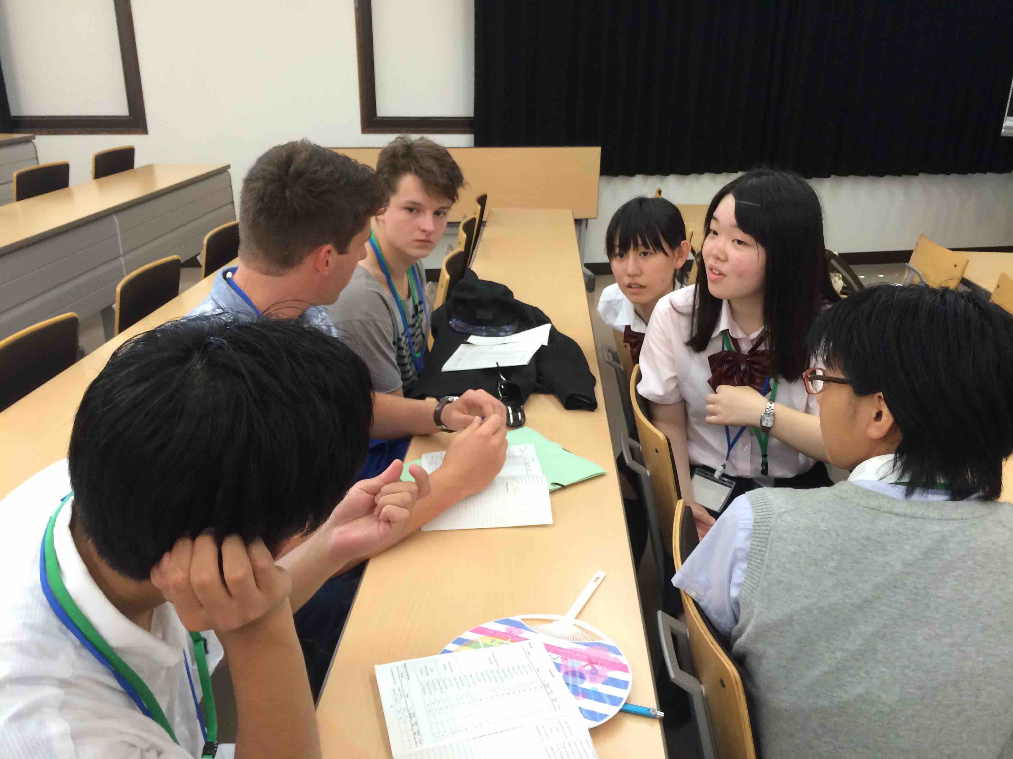
Preparation of presentations

Slide 49
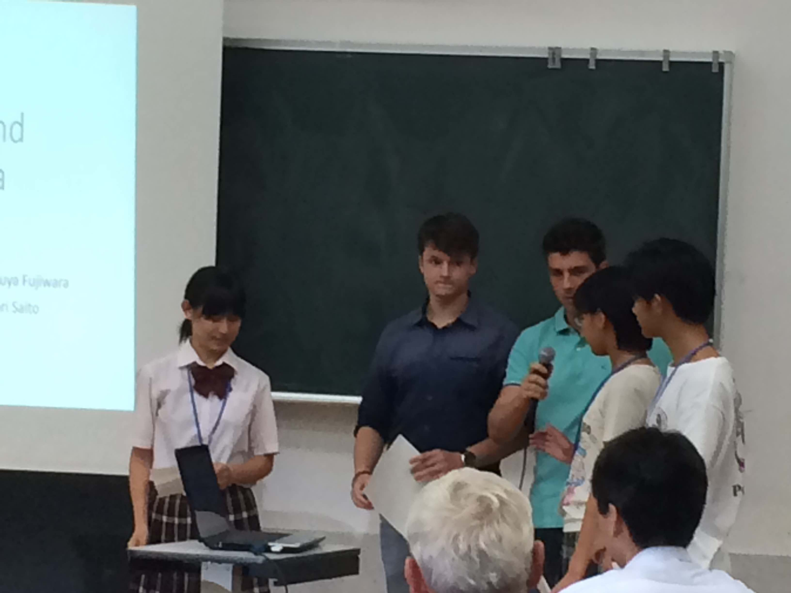
Presentation at the final seminar

Slide 50
Lessons from the workshops
The workshops allowed to "play down" the issue of radiation exposures for students and teachers
They also allowed to raise awareness on the real issues and to organize vigilance if necessary
For example students became aware of the issues in the contaminated areas of Chernobyl and Fukushima, those associated with exposures to radon in dwellings or to medical exposures
They showed that it was possible to address the issue of radiation through the scientific disciplines but also the literary and artistic ones, and that the history of radiation was indissolubly associated with the history of the twentieth century

Slide 51
Concluding remarks
Although X-rays and radioactivity were discovered more than a century ago, few citizens are informed about radiation and even less about radiological protection
Unlike some scientific discoveries of the same period, as for example the one from Pasteur which is now part of the culture of everyday hygiene largely through education at school, radiation protection remains essentially a reserved domain of scientists, experts and professionals
Lessons learned with high school students in France and abroad tell us that it is possible to develop a narrative on X-rays, radioactivity and radiation protection to foster the development of a practical radiation protection culture among future citizens in apart from exceptional circumstances such as post-accident situations

Slide 52
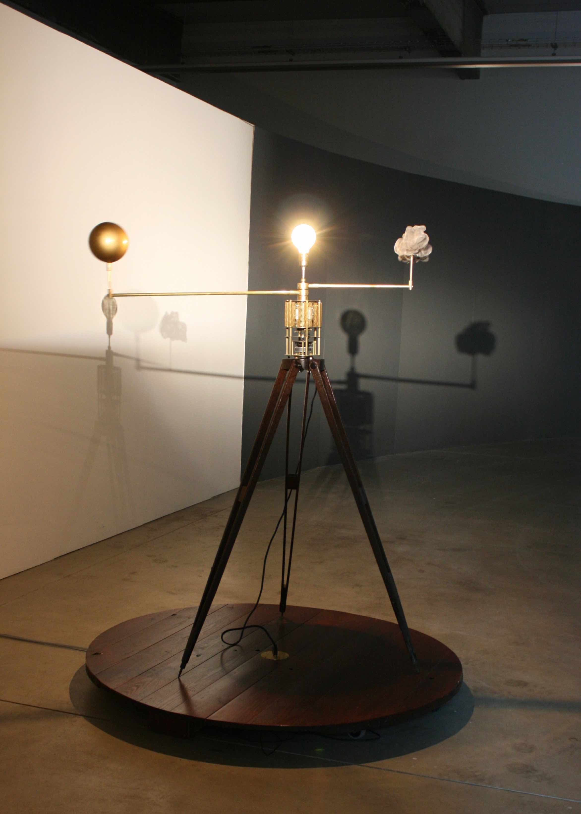
Thank you for your attention
http://www.cepn.asso.fr
Gone with the Wind
Piet.sO & Peter Keene

