Slide 1
Communicating with stakeholders in post-accident situations: some lessons from Chernobyl and Fukushima
Jacques LOCHARD
ICRP Vice-Chair
First Conference on Science, Technology, and Society (STS)
Perspectives on Nuclear Science, Radiation, and Human Health:
The View from Asia
27-28 November 2014
Hiroshima, Japan
This presentation has neither been approved nor endorsed by ICRP

Slide 2
« Whatever men do or know or experience can make sense only to the extent that it can be spoken about. Men in the plural, that is, men in so far as they live and move and act in this world, can experience meaningfulness only because they can talk with and make sense to each other and themselves ».
Hannah Arendt
The Human Condition
2

Slide 3
Information and communication
Informing: a one-way process
Transmitter ➔Media ➔ Receiver
To inform is to let somebody know something
Communicating: a two-way process
Transmitter ➔ ⬅ Receiver
The process requires that the communicating parties share an area in common
A dialogue is a communication between several persons or groups of persons
The basic function of language is not to inform but to relate events and to tell stories i.e. to evoke
3

Slide 4
The human dimension of post-accident situations (1)
The irruption of radioactivity in the daily lives of people is a rupture, which creates an unprecedented situation and deeply upsets the relationship of everyone to her/himself, others and her/his environment
The accident is creating a complex situation generating a lot of questions and concerns among the affected population (those living in contaminated areas and the evacuees)
The technical answer to improve the radiological situation (decontamination, interdictions and restrictions, controls of food,…) has indirect effects that isolate affected people from their day-to-day environment
The compensation scheme severely disrupts human relationships
The accident has an important emotional and social impact that challenges lifestyles and leads everyone to search a way to reconstruct her/his life
4

Slide 5
The human dimension of post-accident situations (2)
The radioactive contamination is a disquieting presence
Invisible, impalpable, uncatchable
Everywhere in the environment and living places
Intruding the private sphere and lasting for several generations
And an unspeakable presence
Unknown by most people. No past experience, no memory
No words in the common language
Faced with radioactivity, people do not know how to express the fear of danger
The lack of experience and words to apprehend radioactivity led to all sorts of odd representations
5

Slide 6
The human dimension of post-accident situations (3)
For each individual, the presence of radioactivity modifies her/his relationship to himself
General feeling to be confronted to a danger without the ability to put the risk in perspective
As a consequence everyone is envisaging the worst and faced with the thought of death
For each individual, the presence of radioactivity modifies her/his relationship to other people
A difference is immediately settled between those who have been affected and those who have not been affected
Residents of the affected areas feel strongly discriminated

Slide 7
The human dimension of post-accident situations (4)
For each individual, the presence of radioactivity modifies her/his relationship to the territory
Familiar environments such as garden or recreational areas become hostile and the affected areas are disqualified on the social and economic levels
Affected people have a different vision of landscapes and symbolic sites as before the accident
For each individual, the presence of radioactivity questions her/his relationship to the collective memory of the nation
Everyone turns to the memory and History of the country and of the affected areas to find a way of thinking the event: Chernobyl: the Gulag and World War II, Fukushima: Hiroshima/Nagasaki, the Lucky Dragon

Slide 8
The human dimension of post-accident situations (5)
The difficulties to manage the situation leads everyone to look for scapegoats
Authorities and experts are communicating with scientific and technical arguments to answer to the worries and interrogations of the population
These arguments are generally not understood by the people who persist in their questioning, in particular concerning the risk of radiation
Facing this situation, authorities and experts tend to put the blame on the population
The affected population accuses authorities of unpreparedness, delays, misunderstanding but also mismanagement, negligence or even abandonment.

Slide 9
The human dimension of post-accident situations (6)
In summary, the Chernobyl and Fukushima accidents have revealed:
Loss of confidence in authorities and experts
Strong worry about health and especially about children health
General feeling of discrimination and exclusion
Feeling of helplessness and abandonment
Loss of control on daily life and apprehension of the future
Finally, each individual is permanently confronted to the dilemma:
To continue to live in the affected territories or to leave them
To return or not at home
9

Slide 10
The difficulty of communicating in post-accident situations
On one side the affected population is facing an unknown situation that raises many concerns in relation to the presence of radioactivity in their close environment and people have no words to speak about this situation
On the other hand, authorities and experts (those who have knowledge) use a language that does not make sense to people. They try to reassure them and they focus their messages (information) on the risk issue but the focus on the risk leads affected people in a bind
In fact, what people want to know is whether their own situation is problematic, and if this is the case, what is possible to do to improve it. And they are ready to invest themselves personally if they can do something for it
10

Slide 11
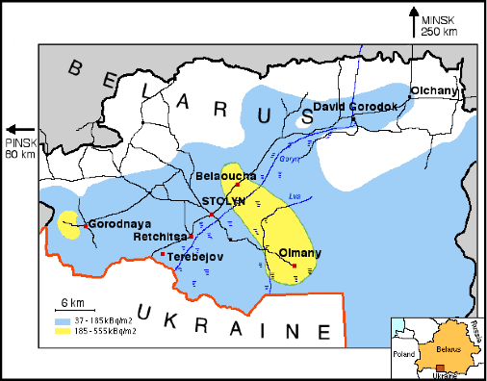
The Ethos Project – Belarus (1996-2001)
11

Slide 12
The Ethos Project - Dialogue meeting with farmers -
12

Slide 13
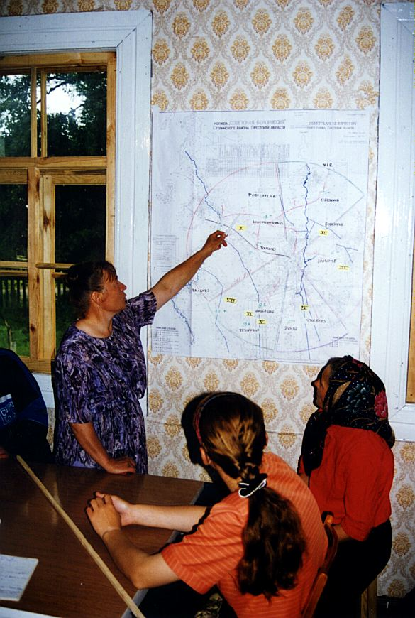
The Ethos Project - The pasture management -
13

Slide 14
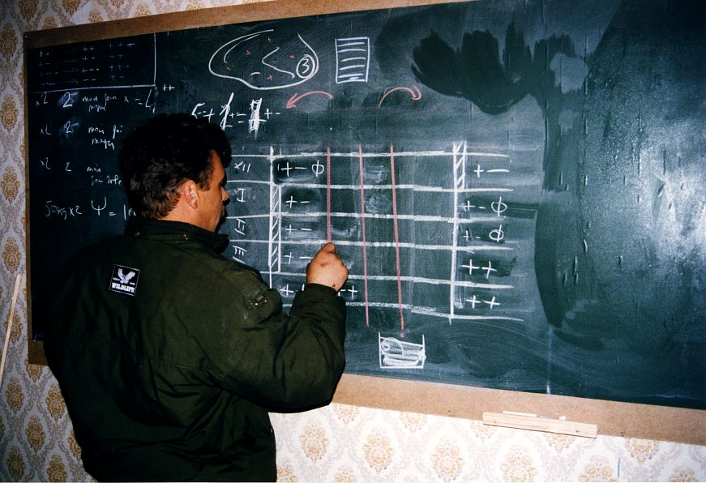
The Ethos Project - Producing clean milk -
14

Slide 15
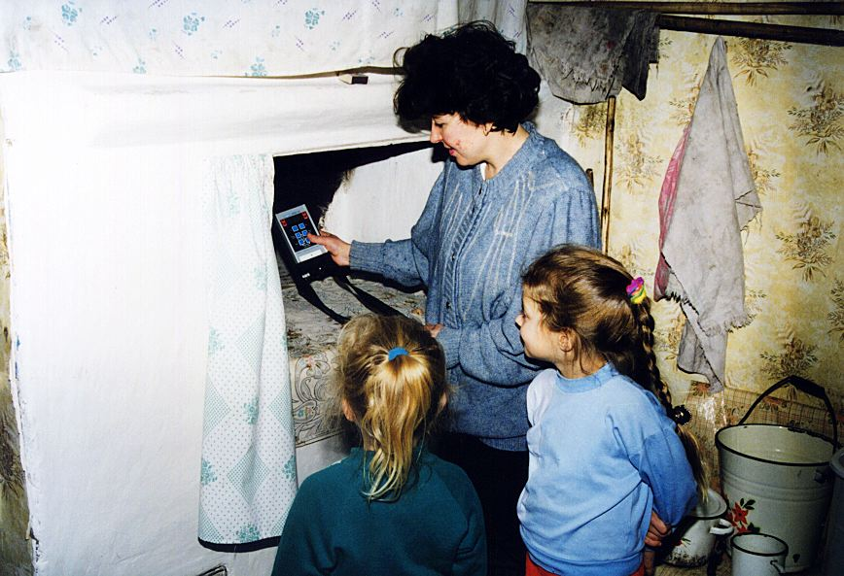
The Ethos Project - The measurement of ambient dose rates in houses -
15

Slide 16
The Ethos Project - Mothers analysing and sharing information -
16

Slide 17
The Ethos Project - In kindergarten -
17

Slide 18
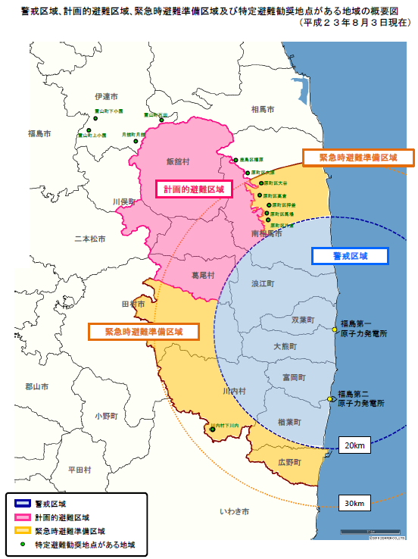
The experience of the Suetsugi community in Fukushima - About 500 inhabitants before the accident, about 300 after -
Initiated by the “Suetsugi, Our Hometown” and the “Ethos in Fukushima” NGOs
Supported by volunteers - locals and from all over Japan - including experts
Dialogue meetings and decision making together
Measurement of soil contamination, ambient dose rates, external and internal individual exposures
Sharing of information and comparing individual experiences
Use of social media (Web, Twitter,…) to exchange information and find support
Suetsugi
18

Slide 19
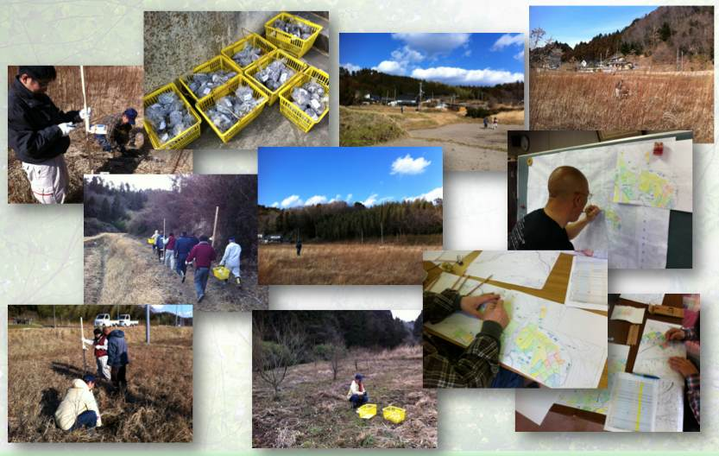
Measurements of soil contamination and ambient dose rates in rice paddies early 2012
19
Borrowed from Shinya Endo
Notes:
19

Slide 20
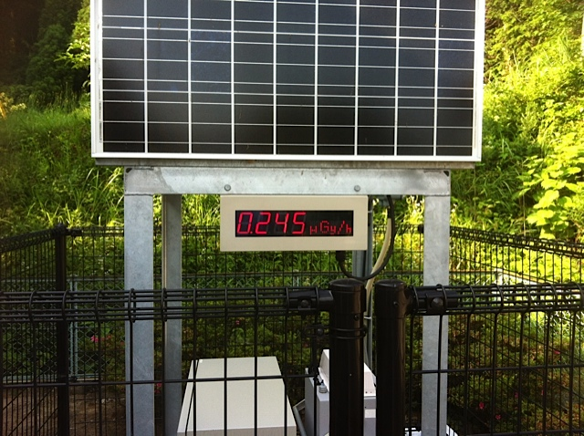
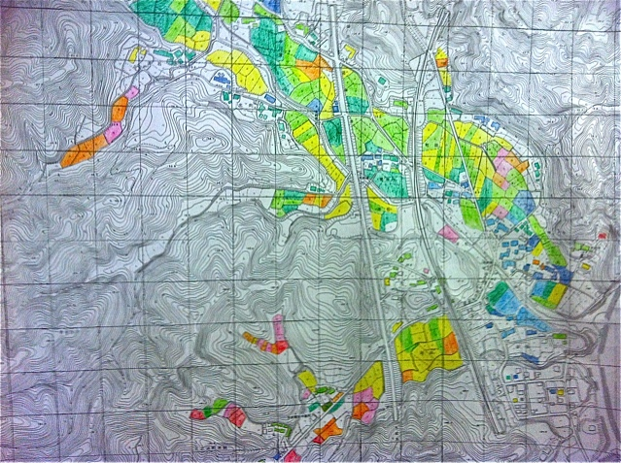
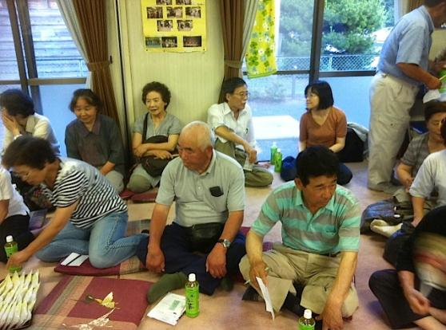
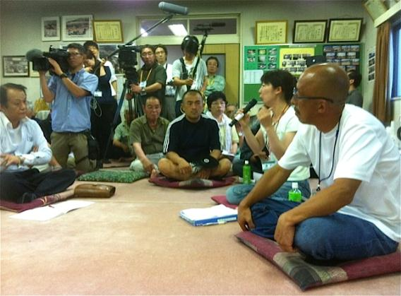
First meeting with ICRP – July 2012 - Questions and concerns -
20
Notes:
20

Slide 21
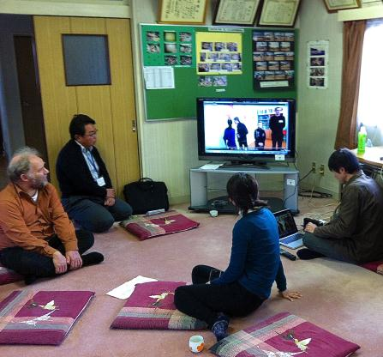
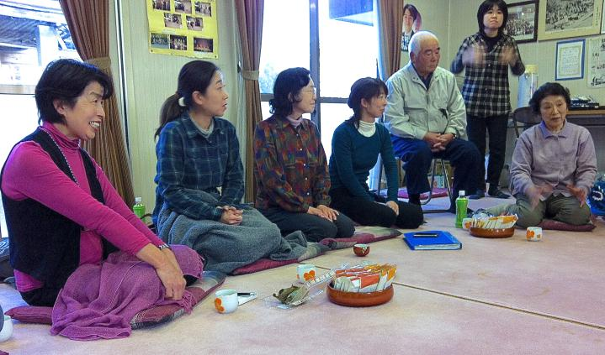
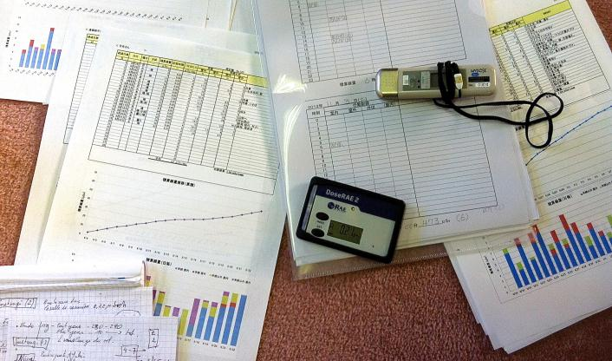
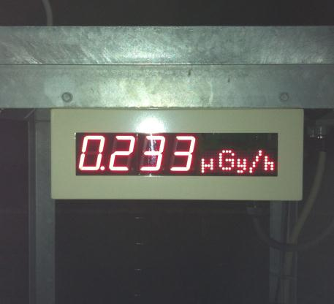
Second meeting with ICRP – November 2012 - Discussion on first measurements of external doses -
21
Notes:
21

Slide 22
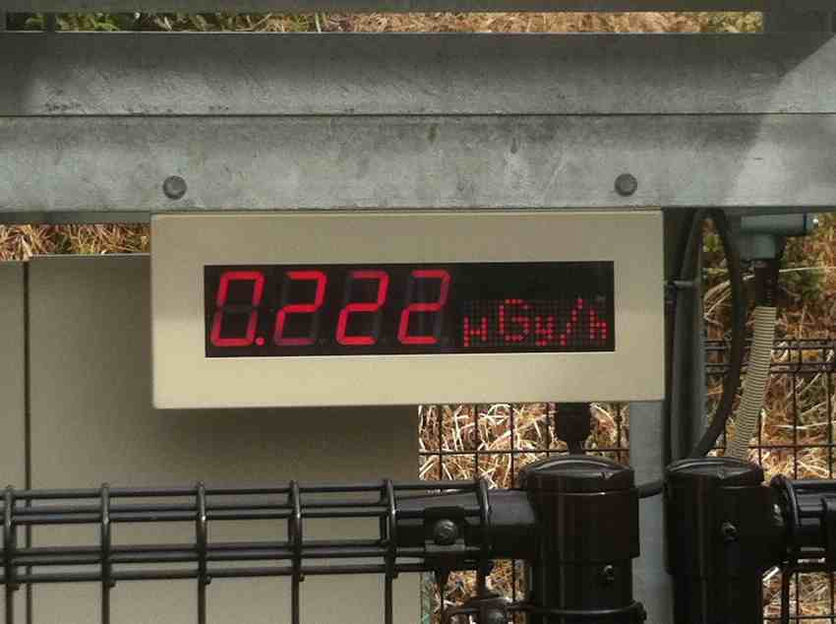
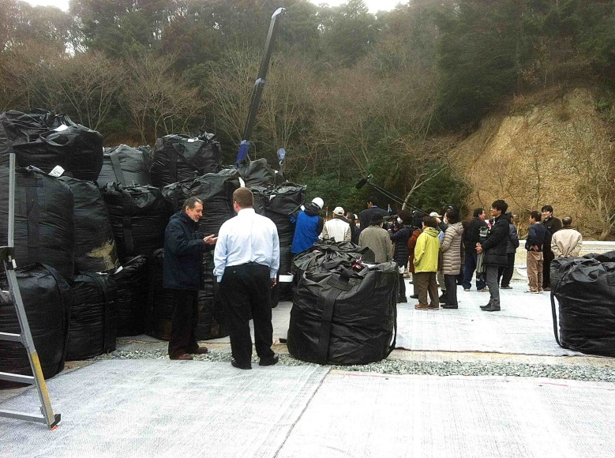
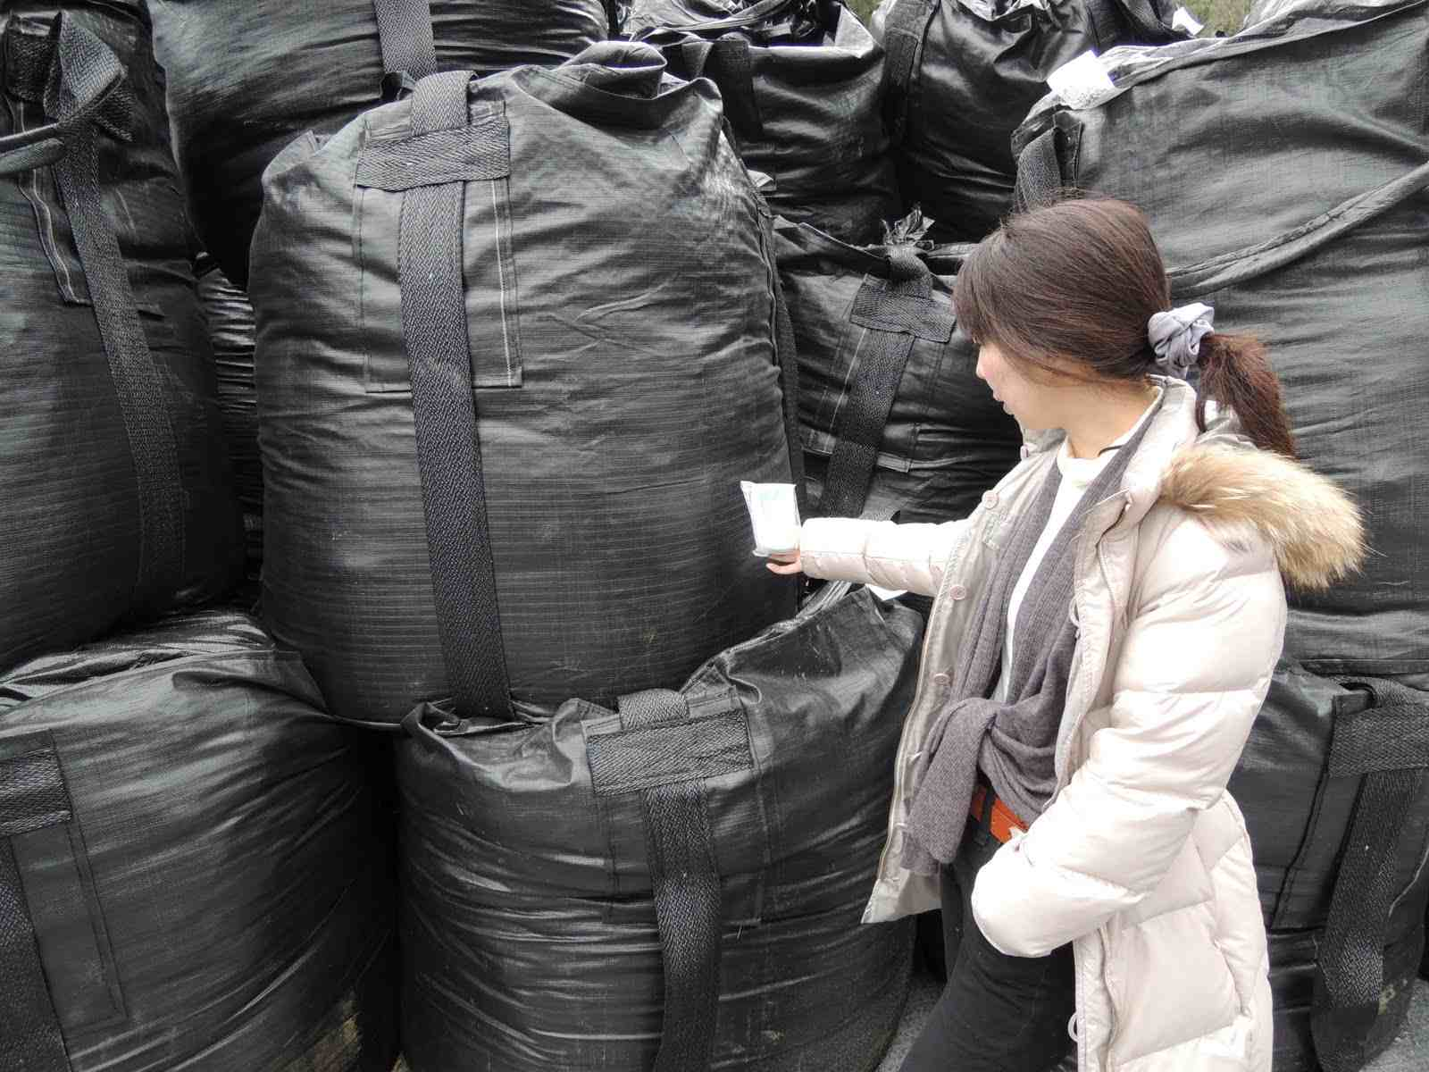
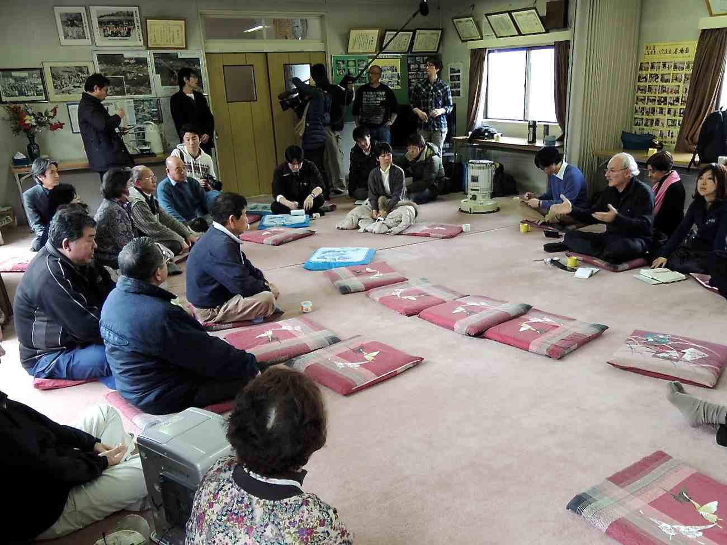
Third meeting in Suetsugi – March 2013 - Visit of the decontamination waste disposal site -
22

Slide 23
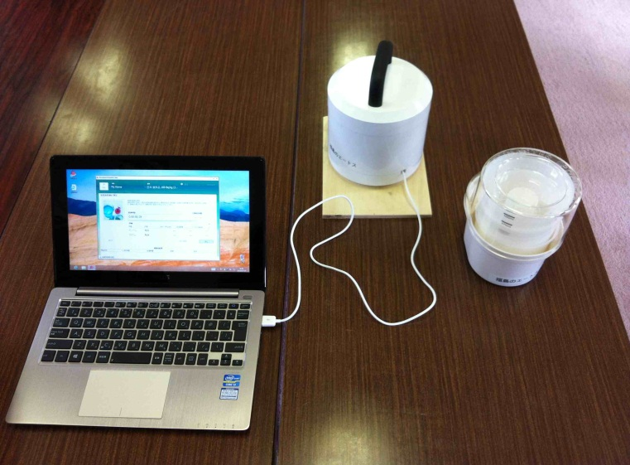
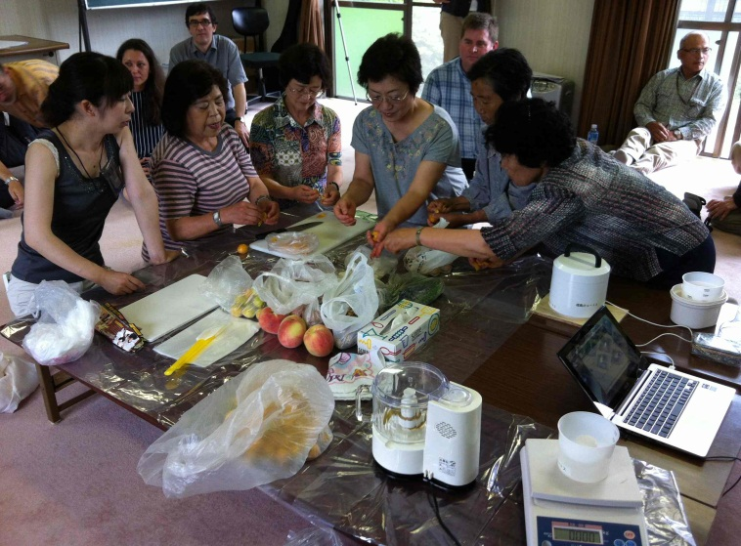
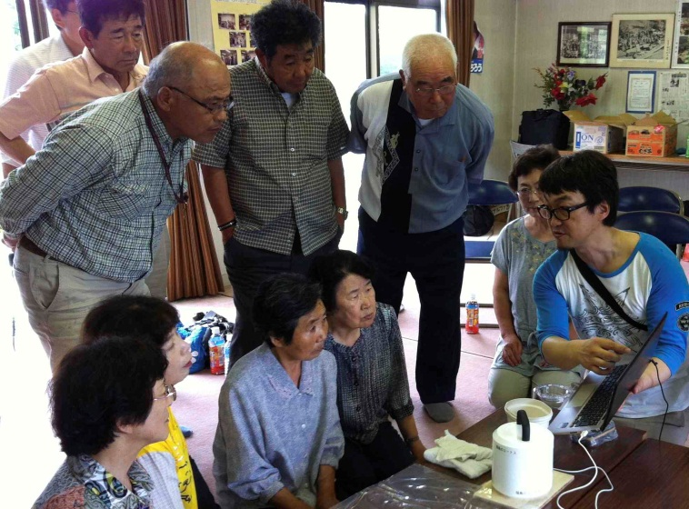
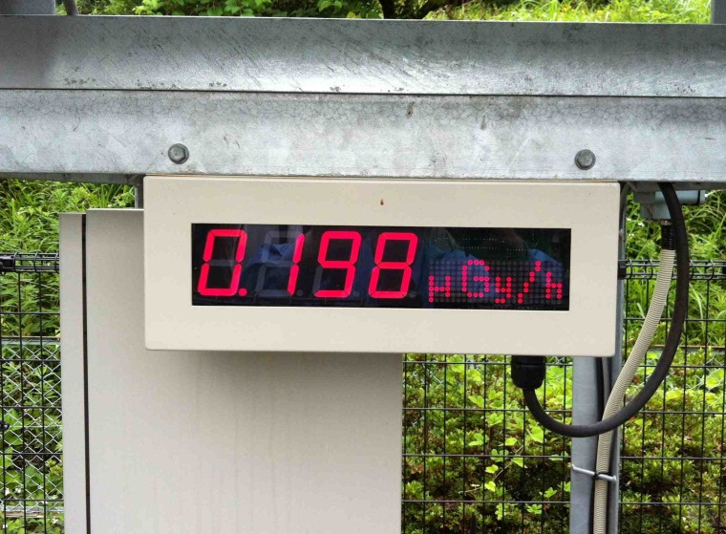
Fourth meeting with ICRP – July 2013 - Dose measurements of the products of local gardens -
23

Slide 24
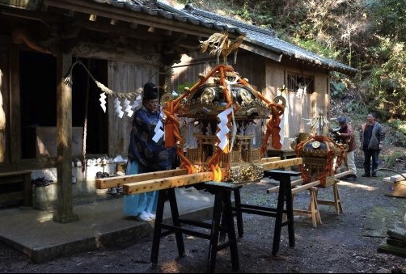
Preparing for the Suetsugi festival – April 2014
Photo © Jun Takai
24

Slide 25
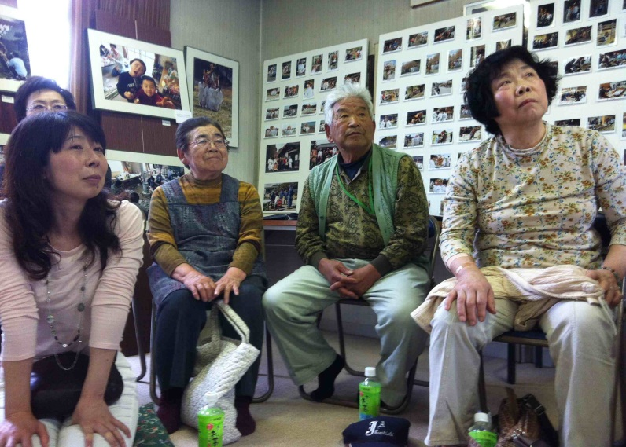
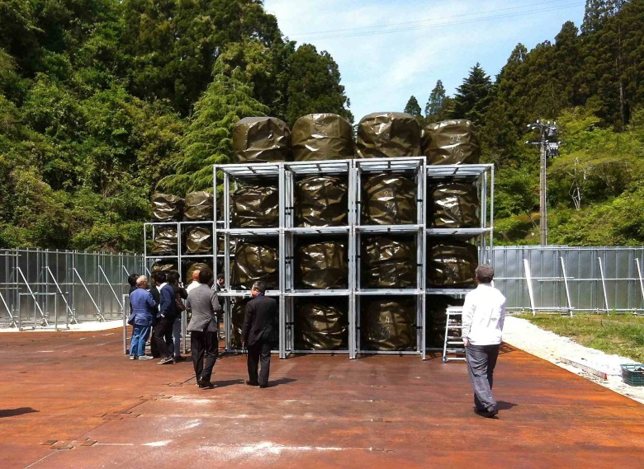
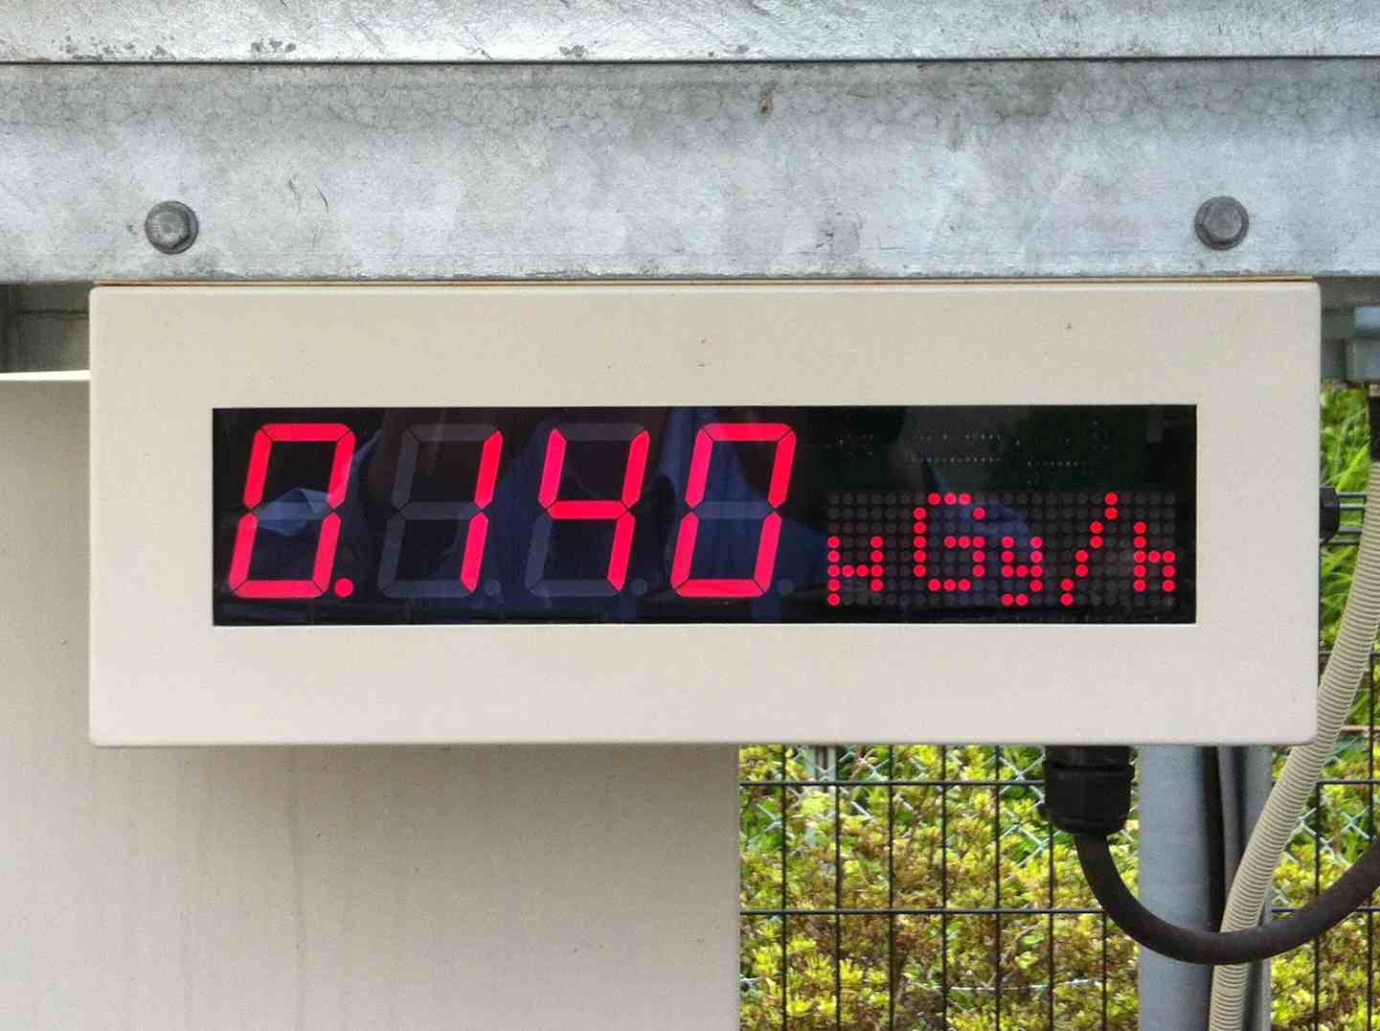
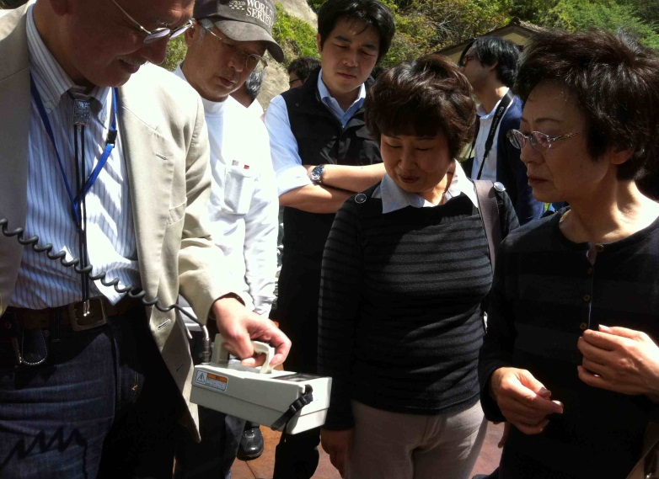
Fifth meeting with ICRP – May 2014 - Visit of the temporary storage site of the Iwaki incinerator fly ashes -
25

Slide 26
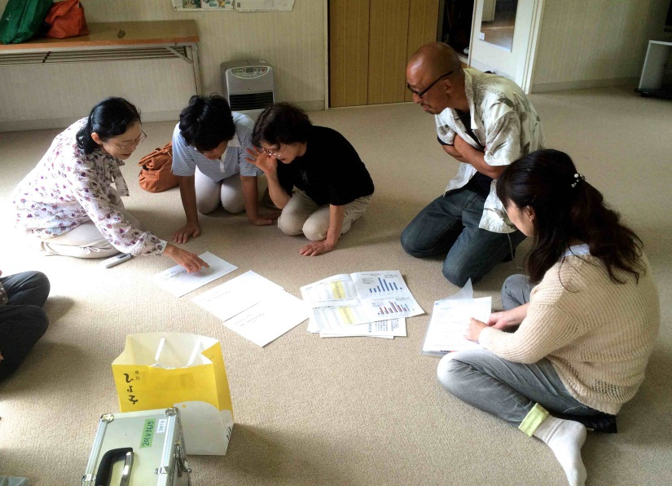
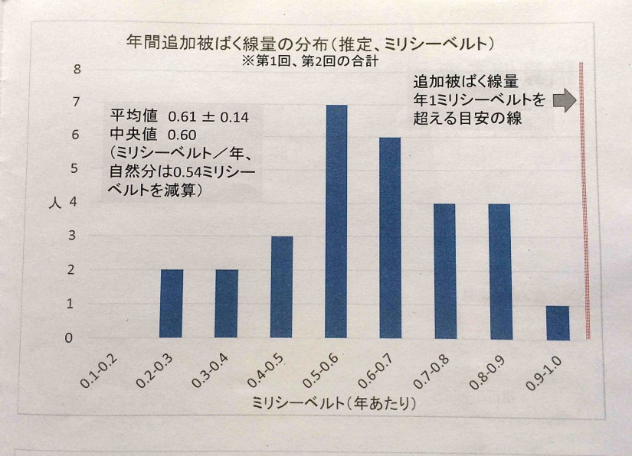
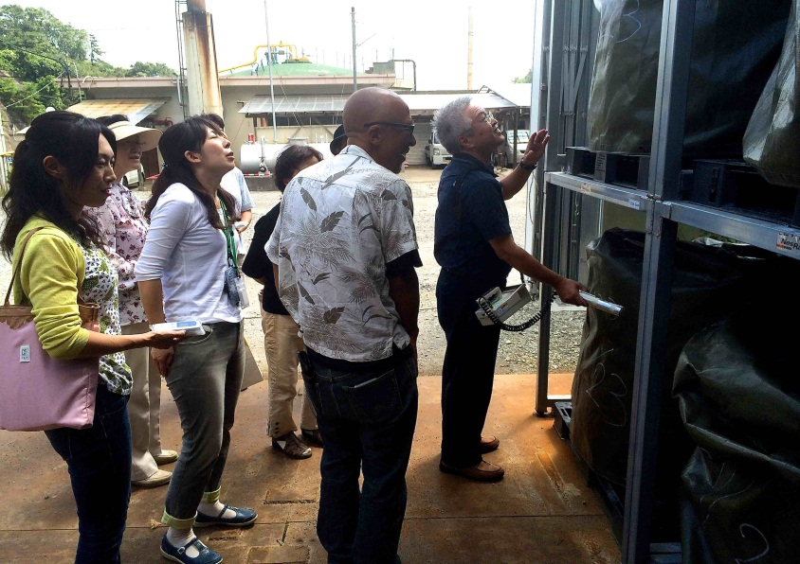
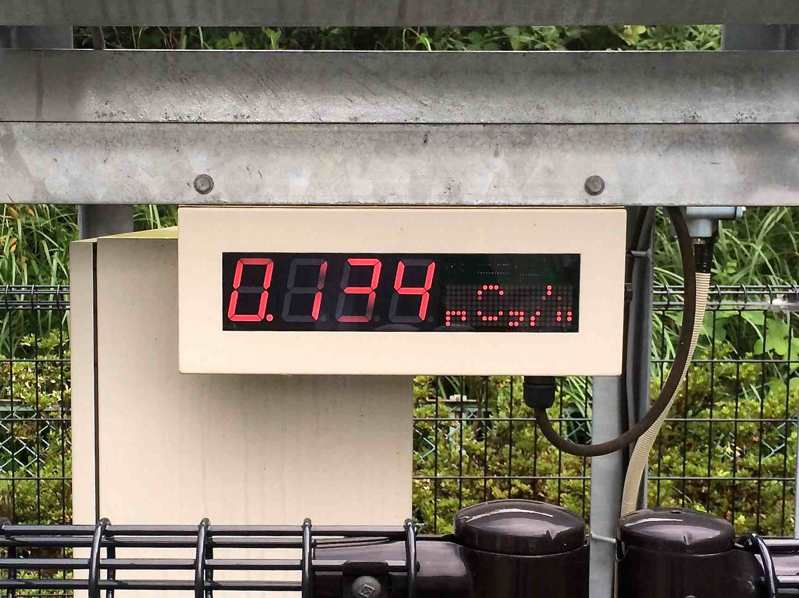
Sixth meeting with ICRP – September 2014 - Information sharing and routine monitoring of the storage site -
26

Slide 27
Lessons from the Suetsugi community
The Suetsugi experience confirms that the direct engagement of the affected people in the day-to-day management of a long-term contaminated territory is not only feasible but necessary for each individual to regain control on her/his radiological situation as well as also restoring her/his autonomy of decision
The people of Suetsugi who engaged in the rehabilitation of their living conditions with the support of voluntary experts also regained their dignity and felt more solidarity than before the accident
After remaining a long time voiceless and awaiting actions of the authorities and experts, the people of Suetsugi again took initiatives and narrated their lives and achievements since Fukushima
27

Slide 28
Lessons from experience (1)
The Chernobyl experience as well as the first lessons from Fukushima clearly show that the direct involvement of the population in the day-to-day management of a contaminated territory is feasible and necessary to break the vicious circle of exclusion and loss of control
When people understand :
Where, when and how they are exposed?
What can they do to protect themselves ?
they spontaneously engage themselves in their own protection and they progressively take control of the situation they face every day (self-help protection)
28

Slide 29
Lessons from experience (2)
Characterization of the radiological situation at the individual level is essential to ensure that affected people can actively engage themselves in the process of rehabilitation
People want to know about their own situation and are less interested by general information
As experts do not necessarily know the local living and customs of the inhabitants they must cooperate with the population (co-expertise)
To orient themselves people need to know:
The ambient dose rates in their living and recreation places
The contamination of the self-produced or gathered foodstuffs they eat daily
Their internal contamination
This basic information helps everyone to establish links between her/his activities and lifestyle and her/his levels of exposure
29

Slide 30
Lessons from experience (3)
With the help of local professionals (particularly the health care personnel and teachers) it is possible to develop a practical radiation protection culture among the affected population allowing individuals:
To interpret results of measurements
To orient themselves in relation to radioactivity in everyday life
To bring elements to make decisions and take actions
To assess the effectiveness of the protective actions they implement themselves
This practical radiation protection culture can be defined as the knowledge and skills enabling each citizen to make choices and behave wisely in a contaminated environment
30

Slide 31
Lessons from experience (4)
The pluralism of the sources of measurement (public and private, local, regional and national actors) and the establishment of places for dialogue are important to ensure:
Confidence of the population in the progress of the rehabilitation
The development of a common language between all involved stakeholders
The dissemination of the practical radiation protection culture in all segments of the population
When people have direct access to measurements, standards cease to be a limiting/blocking factor for their involvement in the rehabilitation process, but become benchmarks to guide their daily actions and behaviours i.e. an indicator of quality
31

Slide 32
Concluding remarks
It is not the information and risk communication, which leads people to engage themselves in the rehabilitation of their living conditions
It is their involvement in co-expertise processes with the support of experts and authorities which makes possible a true communication and cooperation to improve their everyday situation
The role of experts is to serve local actors and facilitate the development of their ability to assess and manage their own situation. Experts must evolve from the explanation of phenomena to the resolution of problems
32

Slide 33
www.icrp.org

